Slide 1
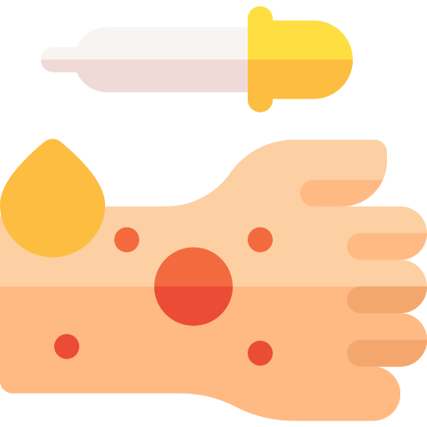
Infected with M.TB (N=30 people)
N= 27 people
(do not develop TB disease)
N= 3 people
(developed TB disease)
>90%
<10%
Immune activation
Failed immune activation
<10%
Immuno suppression
Active disease
Granuloma formulation
Clinical latency
Notes:
tuberculosis have a clinically latent infection; that is, they are infected and purified protein derivative(PPD)-positive by skin test but do not present with clinical symptoms and are not contagious to others.

