Slide 1
Basic concepts of DBT
Ni-kshay Poshan Yojana
Tribal Support Scheme
Treatment supporter’s Honorarium
Incentive for Notification and Outcomes
Incentive to Informants
Incentive to ASHA or CHVs for bank account seeding
Single Nodal Account
FAQs
Contents

Slide 2
Basic concepts of DBT

Slide 3
What is DBT?
D
Direct: to identified beneficiary
B
Benefits: Cash or In - Kind
T
Transfers (Electronic)
Ni-kshay and PFMS enables DBT of incentives into Bank Account of Beneficiaries under various schemes.
Through linking of a TBUs and PFMS agencies.
Beneficiary is a person or entity who receives benefits under an incentive scheme of the Government
Benefit: A payment transaction to Beneficiary

Slide 4
DBT schemes in Ni-kshay
Schemes | Beneficiary | Benefit Amount
Ni-kshay Poshan Yojana (NPY) | Confirmed TB Patients DSTB & DRTB Public + Private Sector Patients | Rs 500 per month
Tribal Support Scheme | Confirmed TB Patients residing in Tribal TU | Rs 750 (one time)
Treatment supporter’s Honorarium | Treatment Supporter | Rs 1,000 for DS TB patients Rs 5,000 for DR TB patients Rs. 250 for TPT patients
Incentive for Notification and Outcomes | Private Health Facilities: Practitioner / Clinic etc. (Single) Hospital/ Clinic/ Nursing Home etc. (Multi) Laboratories Chemists | Rs 500 as Informant or Notification Incentive Rs. 500 for Outcome declaration

Slide 5
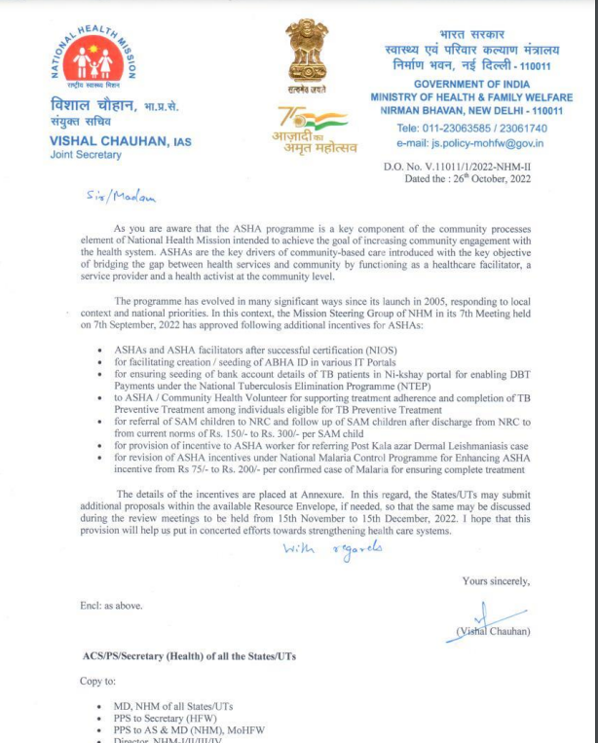
New Incentive (Not a DBT scheme)
Provision of Rs. 50/- to ASHA/Community volunteer for facilitating seeding of bank account within 15 days from the date of treatment initiation.
Notes:
IPB requires only Aadhar Card

Slide 6
Bank details of Beneficiary
Each beneficiary can be linked to unique bank account belonging to him/her.
Beneficiaries without bank accounts need to be facilitated to open bank accounts in any bank as convenient
If a Beneficiary does not have a bank account and is unable to open a new bank account, his/her relative’s bank account may be used (immediate family member such as parents, spouse, siblings).
If a relative’s bank account is used, written consent should be taken from beneficiary.
If a bank account has already been used for another beneficiary, it can not be re-used for another beneficiary
If a new Bank account needs to be opened, its easy to open a zero-balance account with Indian Post Payments Bank.
Notes:
IPB requires only Aadhar Card

Slide 7
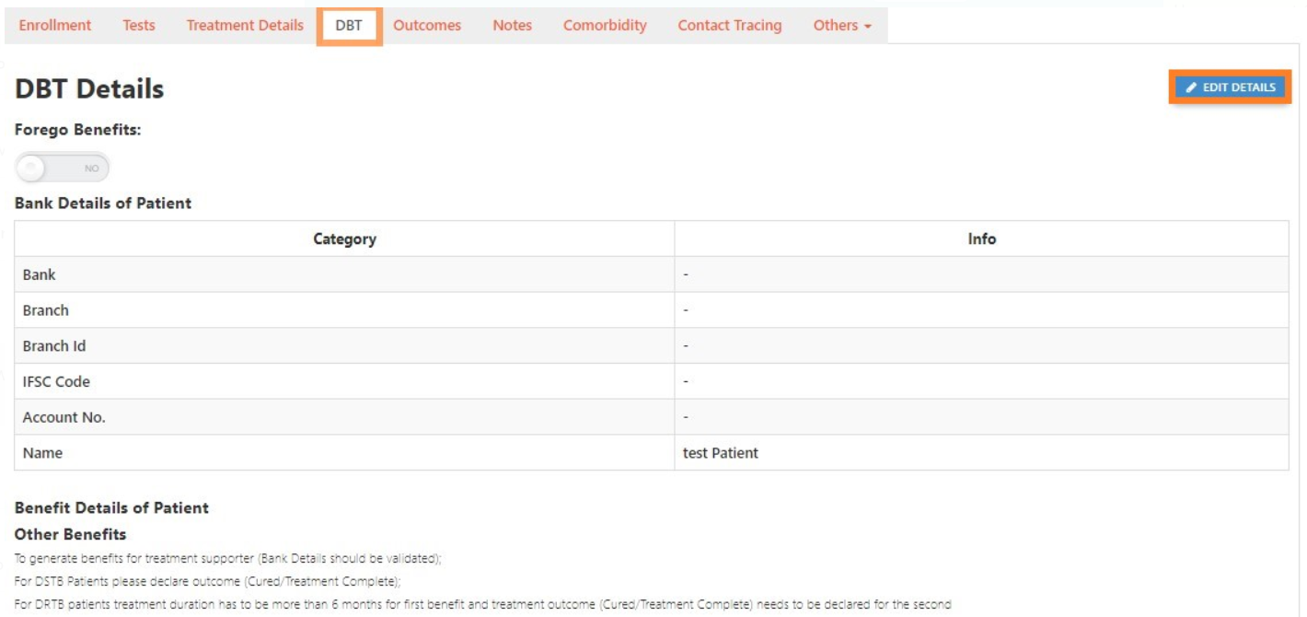
How to enter Bank Details in Ni-kshay

Slide 8
Beneficiary Status
Not Validated
5
Edit in validated beneficiaries require DTO Approval
If Approved, status changes to Entered
4a
Validated
1
Empty
Entered
2
3
Sent to PFMS
Bank details successfully validated by PFMS
Bank details not yet entered in Ni-kshay
Bank details entered in Ni-kshay, pending to be sent to PFMS
Bank details sent to PFMS for validation; response awaited
4b
Rejected
Bank details rejected by PFMS; Check rejection reason & take corrective action

Slide 9
Beneficiary Validation
To process benefit via Ni-kshay, “Beneficiary” should be “validated” by PFMS.
This is a one-time activity. Successful Validation indicates that Beneficiary’s Bank account details are valid
Ni-kshay automatically sends Beneficiary Bank Account details to PFMS on the same day on which they are entered into Ni-kshay (End of day at 12 AM)
PFMS sends the bank account details of the beneficiary to the respective Banks for validation.
If PFMS rejects a Beneficiary for any reason such as, incorrect Bank Account No. or IFSC Code, User has to correct the details in Ni-kshay so that it can be re-sent to PFMS
“Sent to PFMS” beneficiaries bank details will not be allowed to edit unless and until a response is received from PFMS
DTO’s approval is only required when any edit is being made in the “validated” beneficiaries

Slide 10
Benefits
Definition: A payment transaction to someone entitled to receive it
Ni-kshay generates benefits automatically (except for treatment Supporter scheme)
These benefits are displayed in the TU level user (DBT Maker) login
Processing a Benefit in Ni-kshay is a 2-step process:.
Step 1: Review and ‘send for Approval’ by DBT Maker
Step 2: Approval by DTO (DBT Checker)
As DBT Checker approves, the benefit is sent to PFMS for payment. If DBT Checker rejects, the benefit is sent back to DBT Maker
If PFMS processes the benefit, the amount gets credited to the Beneficiary’s Bank Account. However, if PFMS rejects the benefit, it returns to DBT Maker for re-processing.

Slide 11
Benefit Status
4b
Rejected
1
Pending at Maker
2
Waiting for Approver
3
Sent to PFMS
PFMS rejected payment request. User to check rejection reason for corrective action
Benefit pending approval by TU
Benefit pending approval by DTO
Benefit sent to PFMS for processing
4b
PFMS Validated
2a
Removed
3a
Rejected by DBT Checker
5
Benefit Credited
2b
Deferred
2c
Paid External
Notes:
As DBT Maker processes a benefit, s of the Benefit Payment is “Pending at Maker”
As TU User approves, the Benefit record is visible in “Pending” list of DTO (Approver) & its status is “Pending for Approver”

Slide 12
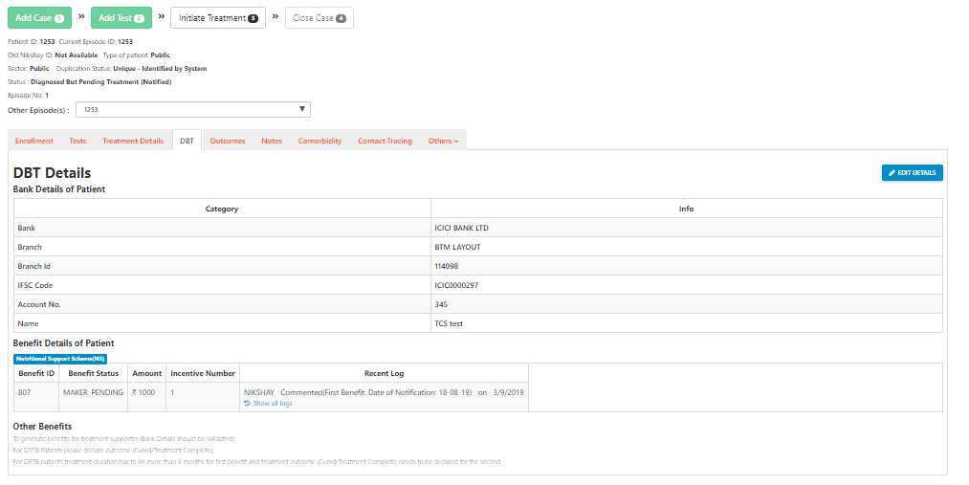
View Benefit details of patient

Slide 13
Roles and Responsibility
Features | General Roles (DTO / TU / PHI / PPSA) | DBT Specific Roles (DBT Maker/ DBT Checker)
View DBT details (Patient Record → DBT) | √ | √
Add/ Edit DBT details (Patient Record → DBT) | √ | X
Beneficiary Approval – Patient/ Private Health Facility | X | √
Available only at DBT Checker Logins
Processing Benefits | X | √
While processing benefits from DBT Checker Logins, OTP is triggered to registered mobile number of DTO

Slide 14
Module 5: Module 5: Ni-kshay Poshan Yojana and Tribal Support Scheme

Slide 15
Overview of Nutrional Support scheme
This scheme is aimed at providing financial support to TB patients for their nutrition. All TB patients notified in Ni-kshay (across India) are eligible to get the benefit under this scheme to mitigate catastrophic costs.
As per the scheme rules, Ni-kshay generates benefits for TB patients. The process that needs to be followed to make payments to the TB patients under this scheme.

Slide 16
How are NPY Benefits generated by Ni-kshay
All the incentives are being paid in advance
Benefits are generated only till the end date has not passed.
Once the end date has passed, benefit generation will stop. To continue benefit generation, end date has to be updated
Benefits will get auto calculated, when an outcome is updated.
Once end date is updated then system will recalculate benefits as per treatment duration and rest unprocessed (Maker_pending & Approver_Pending) benefit will delete if any created.
If all benefits are under “Maker_Pending” process at the time of outcome then system will create a single benefits for whole amount.
If outcome is not updated on time and benefits via Ni-kshay has been processed. Then no benefits will be getting recalculated, if outcome is updated later in Ni-kshay.

Slide 17
How are NPY Benefits generated by Ni-kshay
Incentive Number | Amount | Logics | Duration in Months
1 | Rs. 1000 | On midnight of “Date of Enrolment” from “Date of Diagnosis (Notification)” | 2
2 | Rs. 500 | On midnight of 56 day from “Date of TB Treatment Initiation” | 3
3 | Rs. 500 | On midnight of 28 days from the date of benefit generation for Incentive 2 | 4
4 | Rs. 500 | On midnight of 28 days from the date of benefit generation for Incentive 3 | 5
5 | Rs. 500 | On midnight of 28 days from the date of benefit generation for Incentive 4 | 6
6 | Rs. 500 | If enddate is extended then system will create this benefits as per end date | 7

Slide 18
Steps to be taken in Ni-kshay at TU Level
Step 1
Login with DBT Maker – staff ID

Slide 19
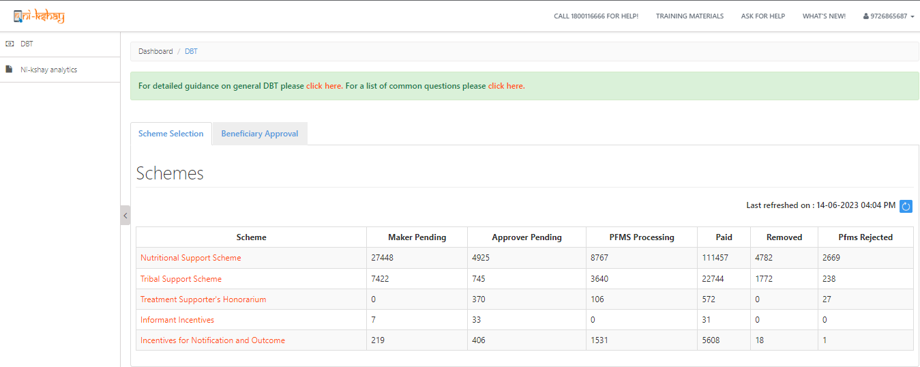
Steps to be taken in Ni-kshay at TU Level…
Step 1
Step 2
Login with DBT Maker – staff ID
Click on Scheme
Login from “DBT Maker – Staff ID”
Scheme wise, Benefit Payment status

Slide 20
Steps to be taken in Ni-kshay at TU Level…
Step 1
Step 2
Step 3
Login with DBT Maker – staff ID
Click on Scheme
Apply DBT Search Filter
Approved, under process at DTO or PFMS
Payments deferred
Approval Pending
Payments removed
Can Search using Patient ID
Payments made
Search filter to be applied based on the above parameter
For processing benefits, Click on Pending Tab and then apply search filter using the above options

Slide 21
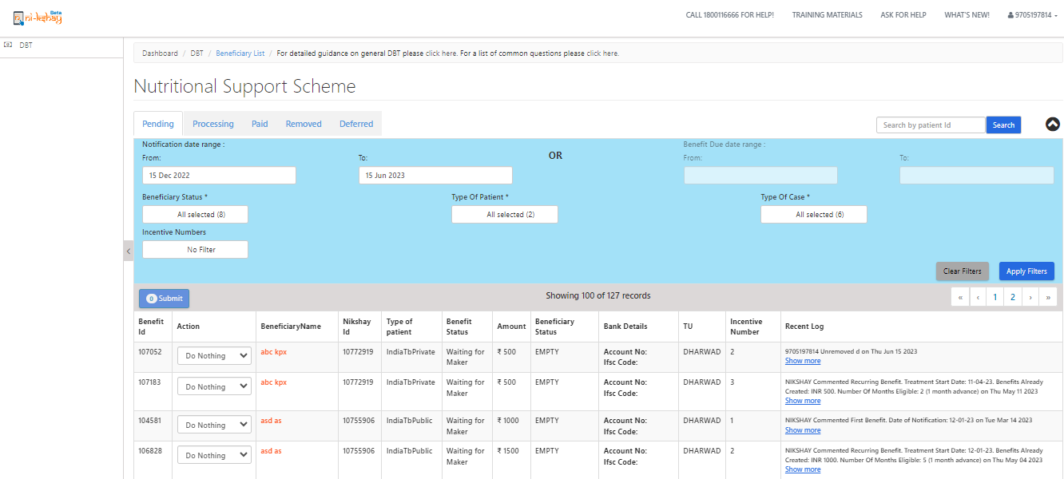
Steps to be taken in Ni-kshay at TU Level…
Step 1
Step 2
Step 3
Step 4
Login with DBT Maker – staff ID
Click on Scheme
Apply DBT Search Filter
View the List of Eligible Benefits
Bank details will not be allowed to edit from “DBT Maker” Login
Clicking on Patient name will allow user to view the patient data only

Slide 22
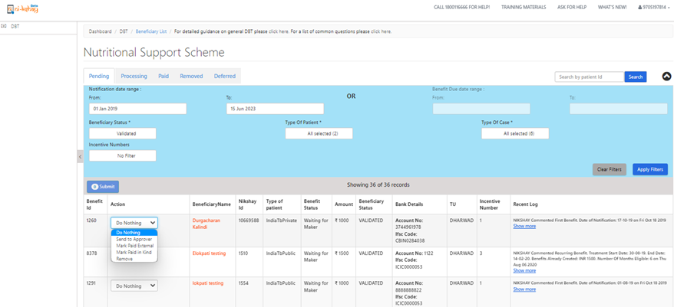
Steps to be taken in Ni-kshay at TU Level…
Step 1
Step 2
Step 3
Step 4
Login with DBT Maker – staff ID
Click on Scheme
Apply DBT Search Filter
View the List of Eligible Benefits
User can Approve only if Beneficiary is validated
“Remove” moves the Payment to “Removed” List
“Mark Paid External” allows user to tag in cases where patient is being paid outside Ni-kshay
Ni-kshay generates Beneficiary list to whom payment is due
Patient added to Pending list of Maker on next day of notification

Slide 23
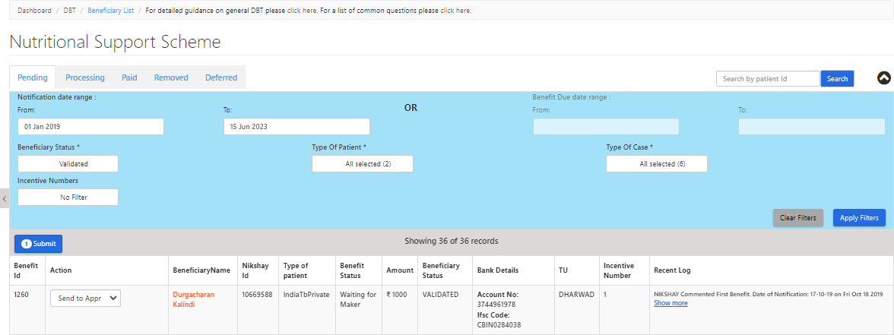
Steps to be taken in Ni-kshay at TU Level…
Step 1
Step 2
Step 3
Step 4
Login with DBT Maker – staff ID
Click on Scheme
Apply DBT Search Filter
View the List of Eligible Benefits

Slide 24
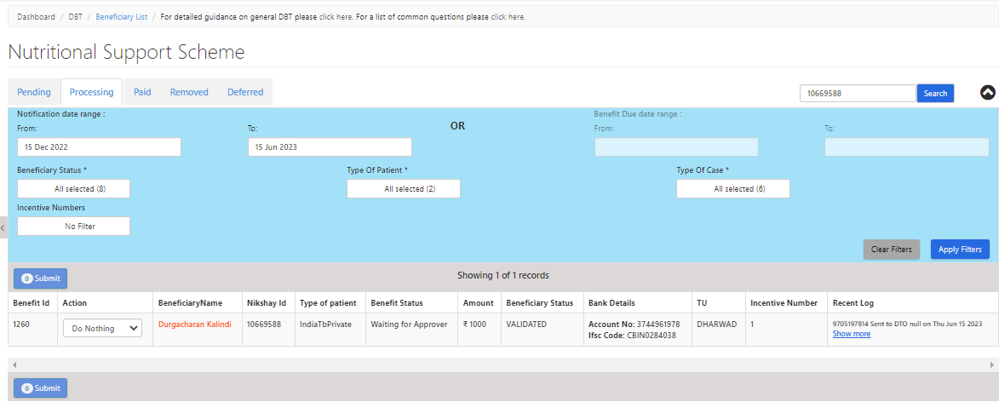
Steps to be taken in Ni-kshay at TU Level…
Step 1
Step 2
Step 3
Step 4
Step 5
Login with DBT Maker – staff ID
Click on Scheme
Apply DBT Search Filter
View the List of Eligible Benefits
Processing Benefits

Slide 25
Steps to be taken in Ni-kshay at DTO Level
Step 1
Login with DBT Checker– staff ID

Slide 26
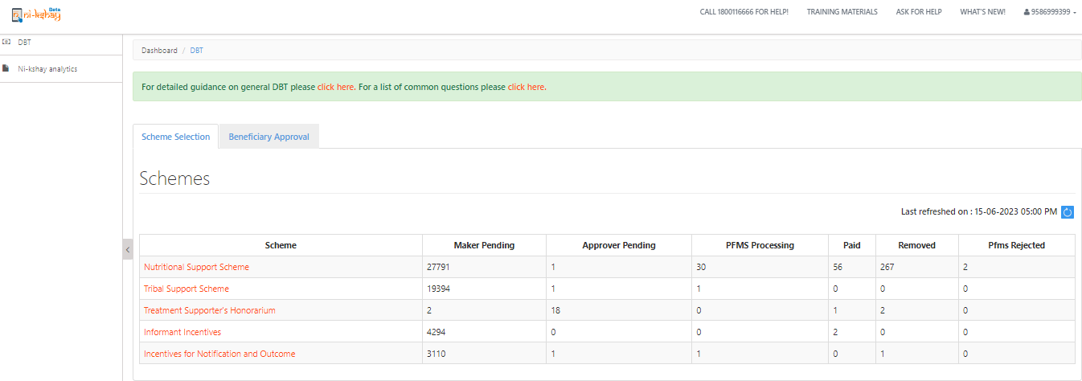
Steps to be taken in Ni-kshay at DTO Level
Step 1
Step 2
Login with DBT Checker – staff ID
Click on Scheme

Slide 27
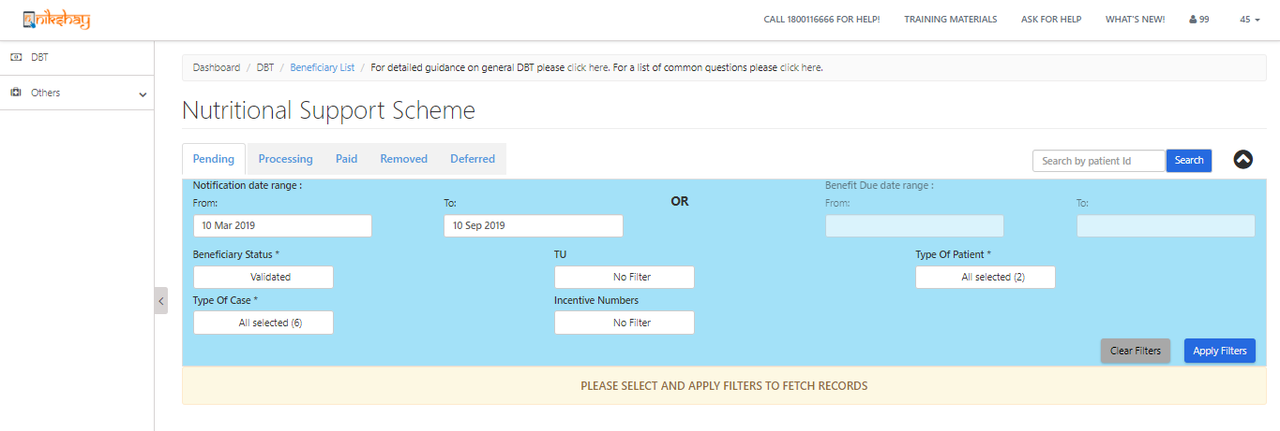
Steps to be taken in Ni-kshay at DTO Level
Step 1
Step 2
Step 3
Login with DBT Checker – staff ID
Click on Scheme
Apply DBT Search Filter
Can Search using Patient ID
Search filter to be applied based on the above parameter
For processing benefits, Click on Pending Tab and then apply search filter using the above options

Slide 28
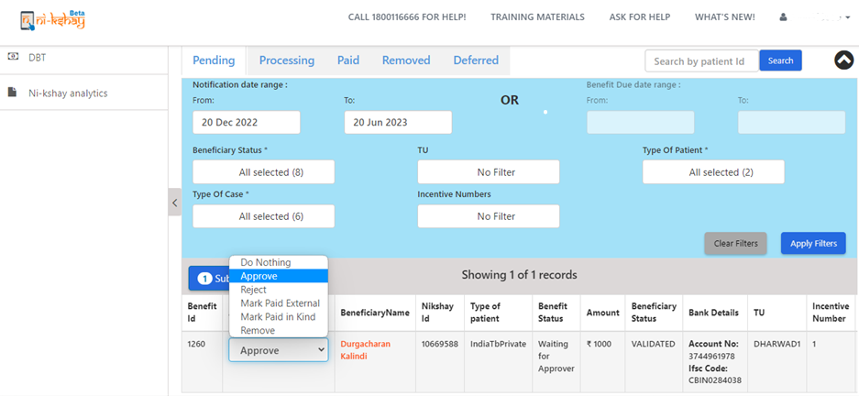
Steps to be taken in Ni-kshay at DTO Level
Step 1
Step 2
Step 3
Step 4
Login with DBT Checker – staff ID
Click on Scheme
Apply DBT Search Filter
View & Process Benefits
Now benefit approve the benefit which was approved DBT maker ID for payment
If you patient is not eligible for this benefit then you may reject/remove it.

Slide 29
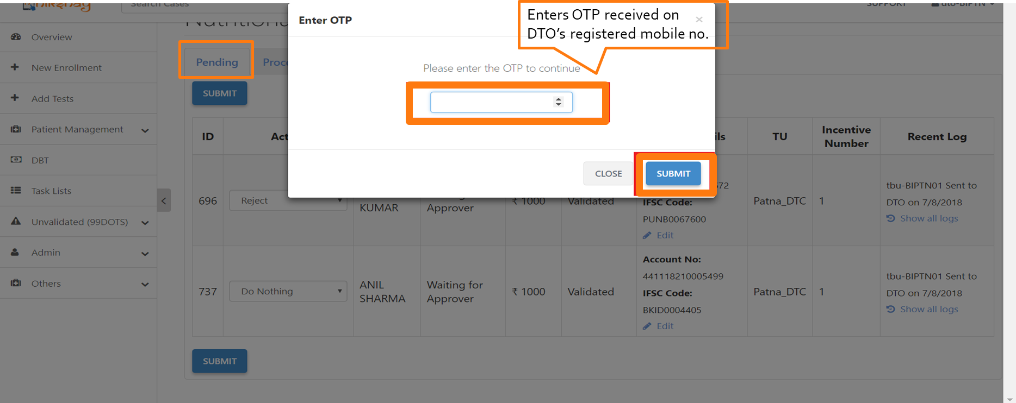
Steps to be taken in Ni-kshay at DTO Level
Step 1
Step 2
Step 3
Step 4
Login with DBT Checker – staff ID
Click on Scheme
Apply DBT Search Filter
View & Process Benefits

Slide 30
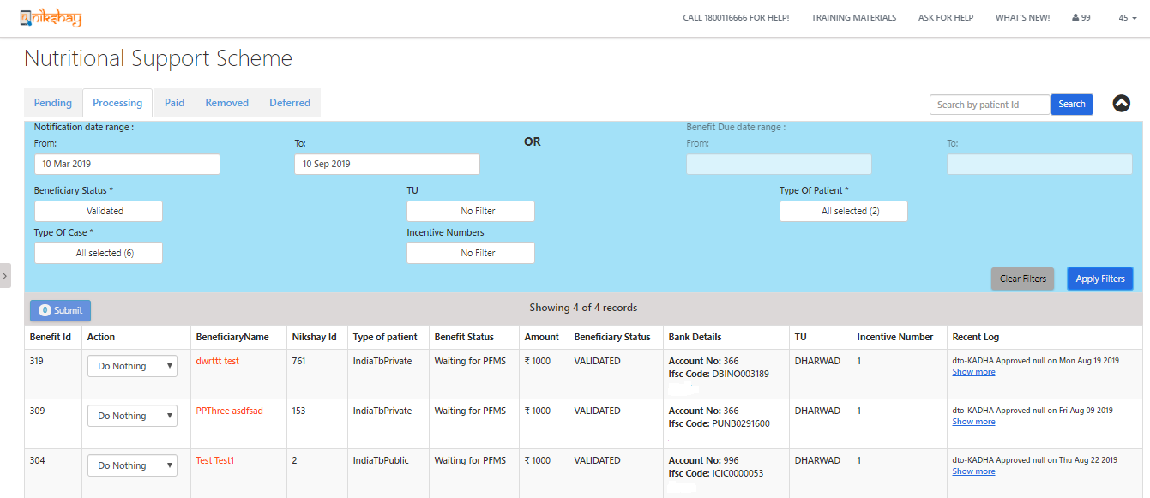
Steps to be taken in Ni-kshay at DTO Level
Step 1
Step 2
Step 3
Step 4
Step 5
Login with DBT Checker – staff ID
Click on Scheme
Apply DBT Search Filter
View & Process Benefits
View Benefit Status
The list of approved benefits will now be visible under “PROCESSING” tab with benefit status as “waiting for PFMS”. Once the PFMS accepts the benefit, the status will change to “PFMS accepted”. Once the payment is successfully processed from PFMS and amount is credited into beneficiary’s account, such benefits will show under the “PAID” tab.

Slide 31
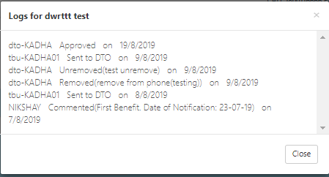
Steps to be taken in Ni-kshay at DTO Level
Step 1
Step 2
Step 3
Step 4
Step 5
Login with DBT Checker – staff ID
Click on Scheme
Apply DBT Search Filter
View & Process Benefits
View Benefit Status
Benefit status can also viewed by accessing the logs in DBT Page
By Clicking on “Show More” against each benefit will give you a complete overview on the benefit

Slide 32
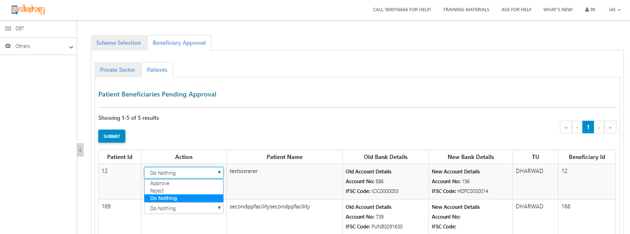
Steps to be taken in Ni-kshay at DTO Level
Step 1
Step 2
Step 3
Step 4
Step 5
Step 6
Login with DBT Checker – staff ID
Click on Scheme
Apply DBT Search Filter
View & Process Benefits
View Benefit Status
Beneficiary Approval by DBT Checker
Available at DBT Checker – Staff Logins
Any Edits made in the validated beneficiary will require DTO approval to Proceed
Beneficiary status at this stage will be “DTO Approval Pending”
Can view both the “Old” and “New” Bank Details entered
If approved, then beneficiary will be “Sent to PFMS”
If Rejected, then beneficiary status will be changed to “Entered” and user has to update the bank details

Slide 33
Benefit Approval in PFMS
All such request payments accepted by PFMS now becomes visible in the DA ID of PFMS under “E-payment” for approval.
Payment advice may be generated for accepted Request Payments, attested by the authorised signatories and sent to the sponsor bank for payment into beneficiaries’ accounts.
Follow-up: Once payment has credited in the beneficiary account, status of the benefit is changed to ‘Paid’ along with relevant details. Else, if error/s occurred in transaction or if transaction was not possible, the payment request will get rejected. Status of all such failed payment requests along with reasons of failure are communicated back to Ni-kshay by PFMS. The user needs to rectify the failure reason/s and re-initiate the benefit.

Slide 34
Steps to be taken in PFMS
Step 1: Login with Data Approver ID

Slide 35
Step 2: Select Approve payment from E-Payment Module

Slide 36
Step 3: Select Updated Scheme, Beneficiary Type and Ref No of the list to be approved

Slide 37
Step – 4: Select the mode of payment and click on approve button to approve the payment.

Slide 38
Step – 5: For printing of PPA, go to e-payment module and select the print payment advice module.

Slide 39
Step – 6: Select updated scheme, bank account and ppa print status to see the list of approved beneficiaries.

Slide 40
Step – 7: Select the payment advice no.To view and print the PPA
Take a print out of the payment advice, get it signed from authorized signatories and deliver it to agency bank before the expiry date.

Slide 41
Tribal Support Scheme
A one-time benefit of Rs. 750 will be generated for a notified patient under Tribal Support Scheme
All notified patients from their "Current Facility" marked as Tribal are eligible for this benefit of Rs. 750 (Under External data, Is Tribal=”Yes”)

Slide 42
Submission of beneficiary list using “Excel upload option” in PFMS
Login using the DO ID

Slide 43
Submission of beneficiary list using “Excel upload option” in PFMS…
Approve payment at DA level and generate PPA
Approval of payment batch:
Login with the DA id > Go to "E-Payment" module > Select "Approve Payment“ > select Beneficiary type and approve the Payment batch from the drop-down list
Printing of PPA:
Login with the DA id > Go to "E-Payment" module > Select "Print Payment Advice" and go for printing.

Slide 44
Patient Transfer Impact on DBT benefit and beneficiaries
Ni-kshay Poshan Yojana Scheme:-
Unprocessed benefits will transfer to the new hierarchy.
Processed benefit will not move to new hierarchy if benefit under PFMS processing.
User should be instructed to clear all backlogs benefits which are already under PFMS Process to avoid the rejection.
Beneficiary status will change if agency code is different and beneficiary status will Change from validated to entered mode, So user should wait for some time to validate the beneficiary to process the benefits which are coming on to new hierarchy.
Tribal Support Scheme:-
Unprocessed benefits will transfer to the new hierarchy if destination TU marked as Tribal area in Ni-kshay
Processed benefit will not move to new hierarchy if benefit under PFMS processing
User should be instructed to clear all backlogs benefits which are already under PFMS process to avoid the rejection.
Beneficiary status will change if agency code is different and beneficiary status will change from validated to enter mode, So user should wait for some time to validate the beneficiary to process the benefits which are coming on new hierarchy

Slide 45
Module 6: Treatment Supporter Scheme - DSTB and DRTB beneficiaries

Slide 46
Who can be a Treatment Supporter
A Treatment Supporter can be any person such as a Medical Officer, MPWs, community volunteers working with the program etc.. Even a patient’s relative can be a Treatment Supporter.
As per NTEP guidelines, salaried NTEP/ General Health System staff may also be assigned as treatment supporters for a patient. However, they will not be eligible for any honorarium.
A patient can only be linked to one treatment supporter at a time.
Staff and Treatment Supporters

Slide 47
Role of a Treatment Supporter
The Treatment Supporter is a person who helps a TB patient to complete his treatment
They explain the patients about TB treatment and inform them about the treatment facilities provided by the government
They encourage patients to take the prescribed TB medication regularly, on schedule, for the full duration of the treatment
They record the patient’s treatment adherence details on the treatment card
They help the patients to visit nearest health facility for regular health check ups and conduct the follow-up tests on time
If the patient faces any health issues such as ADR, refers the patient to the health facility
Staff and Treatment Supporters

Slide 48
About the Treatment Supporter Honorarium Scheme
Eligibility: Honorarium to be disbursed upon completion or cure of TB patient as below
For DS-TB /H Monopoly , Rs. 1,000
For DRTB cases, Rs. 5,000
Rs. 2,000 at end of IP (6 months)
Rs. 3,000 on Treatment completion
Treatment Supporter’s Honorarium

Slide 49
DBT processing via Ni-kshay
Following are the 5 steps to be followed for processing payments under this scheme. This is the only scheme in Ni-kshay in which the benefits must be generated manually by TU User.
1
Registration of Treatment Supporter
(Once per treatment supporter)
2
Update Bank details of Treatment Supporter
3
Assign Treatment Supporter to a patient
(Once per benefit)
4
Manually create Benefits
(Once per DS TB patient and twice per DR TB Patient)
5
Approval of Benefit by DBT Checker
(Once per benefit)

Slide 50
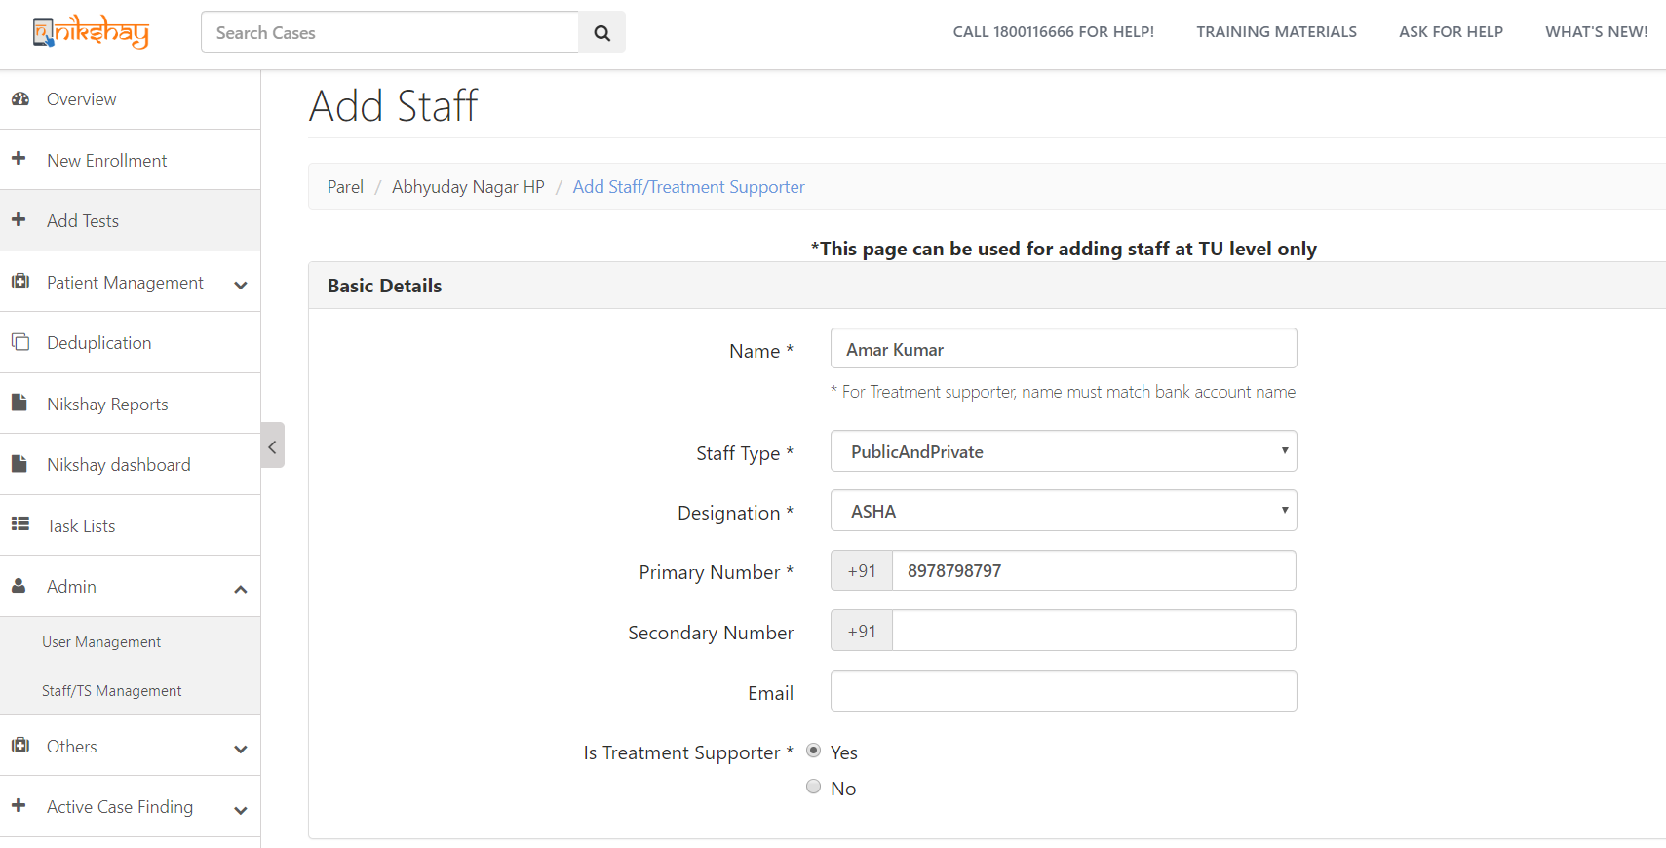
Step 1: Registration of Treatment Supporter in Ni-kshay
Go to Admin 🡪 Staff/TS Management
Note: Treatment Supporters can be created only at TU and PHI levels
Select “PublicAndPrivate”
Mobile No. must be unique
Select “Yes”

Slide 51
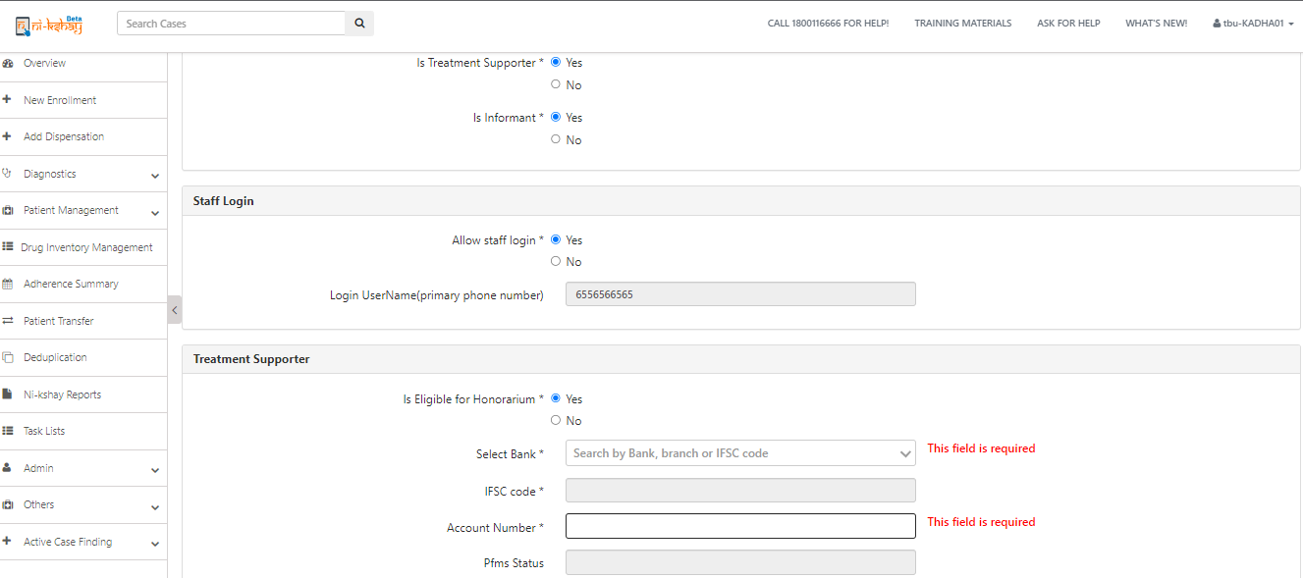
Step 2: Update Bank details of Treatment Supporter
Select Yes
Select Yes
If same staff is Informant then select Yes
Treatment Supporter can login into Ni-kshay and view /edit details of patients assigned
Enter Bank details
As Bank details are entered, its sent to PFMS for validation

Slide 52
Step 3: Assign Treatment Supporter to patient
Open the Patient’s record, Go to “Others” 🡪 “Staff/Treatment Supporter”
Click here to Add

Slide 53
Step 3: Assign Treatment Supporter to patient
Select Treatment Supporter’s Name
Note: The Treatment Supporters of Patient’s current TUs will appear in this drop down

Slide 54
2. Assigning a Treatment Supporter to a Patient
Step 3: Assign Treatment Supporter to patient
Treatment Supporter cannot be unassigned if a benefit has been sent to PFMS or paid
A Treatment Supporter can be unassigned by clicking the delete button

Slide 55
Step 4: Manually create Benefits
Benefit can be created only if the following conditions are met:
A staff (Treatment supporter = Yes) is assigned as Treatment supporter to the patient
The assigned staff has Eligible for Honorarium = Yes
Treatment Supporter’s Bank details are validated by PFMS
Treatment Status of patient:
For DS TB patient, one benefit of maximum amount of Rs. 1,000 can be created if outcome is updated as “Cured” or “Treatment Completed
For DR TB patients two benefits can be generated:
First benefit of maximum amount Rs. 2000 can be created at end IP ( i.e.. Initiation Date + 6 months)
Second benefit of maximum amount Rs.3000 can be created if Outcome is updated as “Cured” or “Treatment Completed”
If all the above conditions are met, TU user can create Benefit for Treatment Supporter

Slide 56
3. Creation of Benefits by TU
Step 4: Manually create Benefits
Login as TU User, open Patient’s Record for which Treatment Supporter Honorarium is to be paid, and Go to ‘DBT’ Tab
If eligibility conditions are met, benefit can be generated by clicking here

Slide 57
Step 4: Manually create Benefits
Enter amount and click on Save

Slide 58
3. Creation of Benefits by TU
Step 4: Manually create Benefits
As user clicks on Save, Benefit will get created and notification displayed
Note:
1. A patient’s episode record cannot be deleted if benefit to the Treatment Supporter has already been sent to PFMS or paid
2. Edit of Case type (DSTB to DRTB/ DRTB to DSTB) will not be possible once benefit is generated under this scheme

Slide 59
Step 5: Approval of Benefit by DBT Checker
Benefit will be available at DBT Checker login for approval.
Benefit Status can be seen here

Slide 60
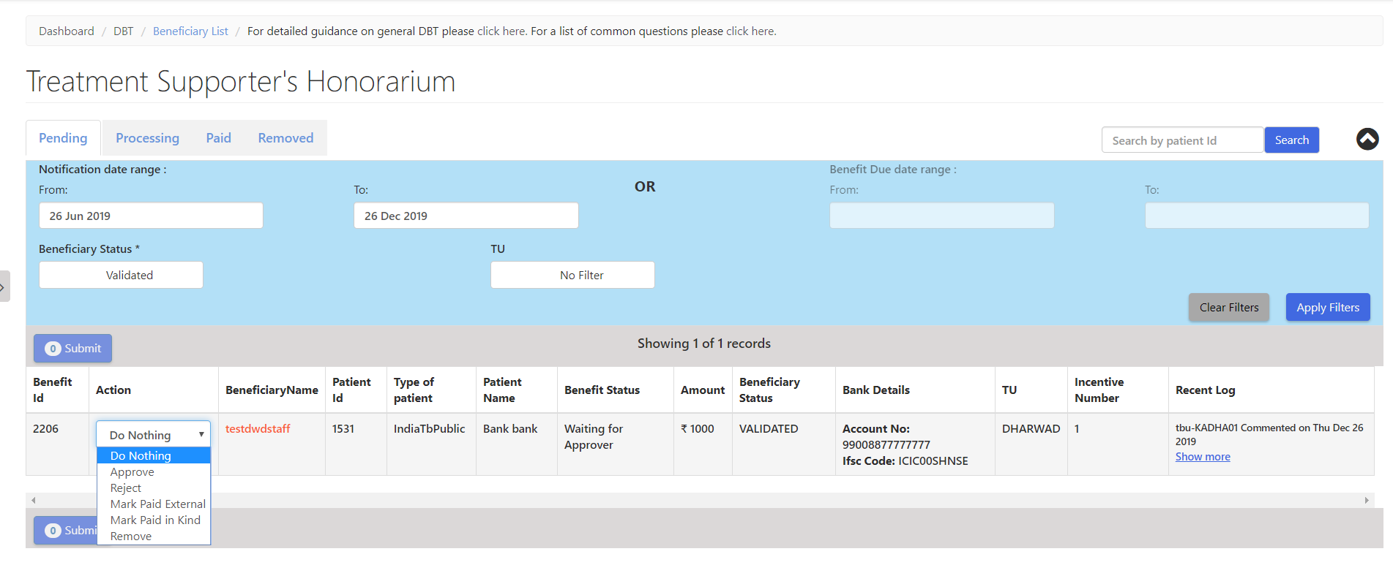
Step 5: Approval of Benefit by DBT Checker
The DBT Checker User will be able to process the Benefits

Slide 61
Staff Transfer Impact on DBT benefits and beneficiaries
Users can register a staff with new bank details and generate a TSS benefit
We will delete all beneficiary bank account number in database which are in old hierarchy to avoid the duplicate pop message while entering bank account details in new hierarchy to same staffs
Processed & Unprocessed benefit will not move with patient to new hierarchy
Users have the option to pay the old hierarchy benefits which are in status “Approver Pending”.
Kindly follow below steps for payment where benefit under “Approver Pending” in old hierarchy.
a. users can remove the treatment supporter from other tab where benefits is not processed
b. After removing the treatment supporter system will delete the TSS benefit which are under “Approver pending” in backend.

Slide 62
Staff Transfer Impact on DBT benefits and beneficiaries
c. User need re-register same treatment supporter with bank details in new hierarchy
d. User can use the same bank details for payment since we have deleted old beneficiary (Isdeleted= 1)
e. Once beneficiary is validated by PFMS for new staff then you can assign the treatment supporter and create a TSS benefit by TU logins
f. After all this process, user can reassign the same Treatment supporter to patient for further process
g. Create a TSS benefit manually from patient DBT page by TU logins
h. Clear all backlogs benefits which are already under PFMS process to avoid the future rejection

Slide 63
Module 9: Treatment Supporter Scheme for TPT beneficiary

Slide 64
Who can be a Treatment Supporter
A Treatment Supporter can be any person such as a Medical Officer, MPWs, community volunteers working with the program etc.. Even a beneficiaries relative can be a Treatment Supporter.
As per NTEP guidelines, salaried NTEP/ General Health System staff may also be assigned as treatment supporters for a beneficiary. However, they will not be eligible for any honorarium.
A TPT beneficiary can only be linked to one treatment supporter at a time.
Staff and Treatment Supporters

Slide 65
Role of a Treatment Supporter
The Treatment Supporter is a person who helps a TPT beneficiary to complete his treatment
They explain the beneficiary about TPT treatment and inform them about the treatment facilities provided by the government
They encourage beneficiary to take the prescribed TPT medication regularly, on schedule, for the full duration of the treatment
They help the beneficiary to visit nearest health facility for regular health check ups and conduct the follow-up tests on time
If the beneficiary faces any health issues such as ADR, refers the beneficiary to the health facility
Staff and Treatment Supporters

Slide 66
About the TPT Treatment Supporter Honorarium Scheme
Eligibility: Honorarium to be disbursed upon completion of treatment for TPT beneficiary as below
For TPT beneficiary , Rs. 250
System will generate the manual benefit only for those TPT beneficiaries who are recorded on or after 1 st October 2022 are eligible for incentive under this scheme
Treatment Supporter’s Honorarium

Slide 67
DBT processing via Ni-kshay
Following are the 5 steps to be followed for processing payments under this scheme. This is the 2nd scheme in Ni-kshay in which the benefits must be generated manually by TU User.
1
Registration of Treatment Supporter
(Once per treatment supporter)
2
Update Bank details of Treatment Supporter
3
Assign Treatment Supporter to a TPT Beneficiary
(Once per benefit)
4
Manually create Benefits
(Once per benefit)
5
Approval of Benefit by DBT Checker
(Once per benefit)

Slide 68
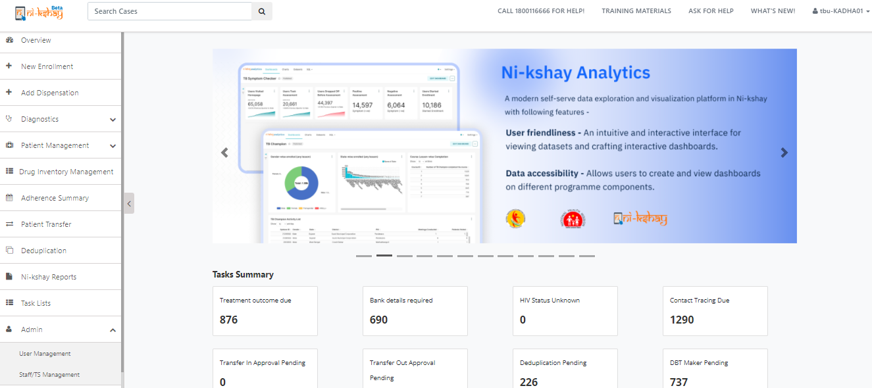
Step 1: Registration of Treatment Supporter in Ni-kshay
Go to Admin 🡪 Staff/TS Management

Slide 69
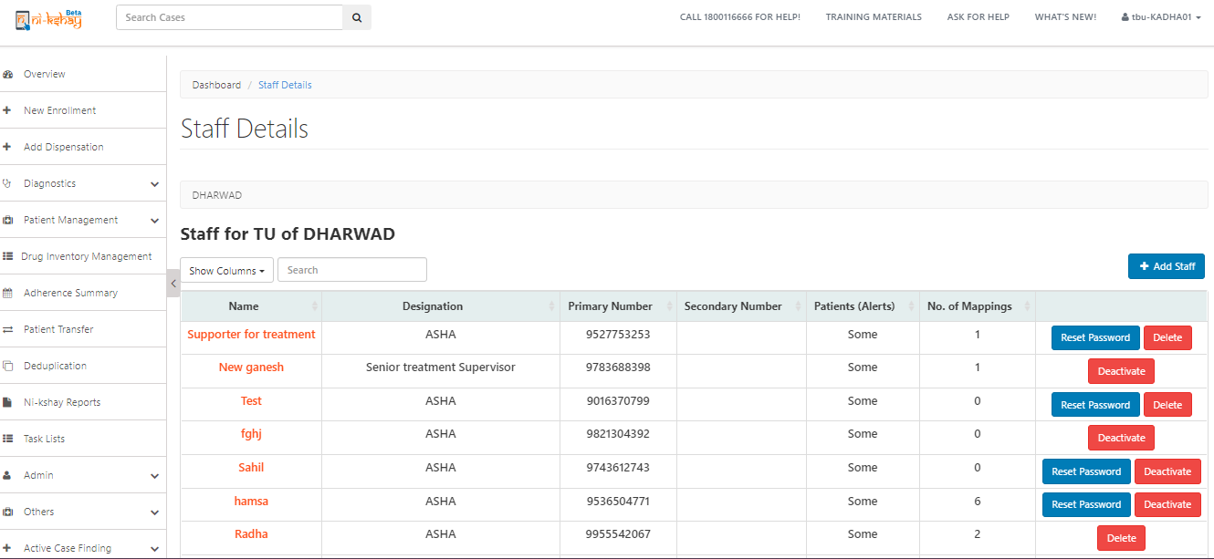
Step 1: Registration of Treatment Supporter in Ni-kshay
Go to Admin 🡪 Staff/TS Management > Staff Details page

Slide 70
Step 1: Registration of Treatment Supporter in Ni-kshay
Go to Admin 🡪 Staff/TS Management
Note: Treatment Supporters can be created only at TU and PHI levels
Select “PublicAndPrivate”
Mobile No. must be unique
Select “Yes”

Slide 71
Step 2: Update Bank details of Treatment Supporter
Treatment Supporter can login into Ni-kshay and view /edit details of beneficiary assigned
Select ‘Yes’
Enter Bank details
As Bank details are entered, its sent to PFMS for validation

Slide 72
Step 3: Assign Treatment Supporter to TPT beneficiary
Open the TPT beneficiary record, Go to “Others” 🡪 “Staff/Treatment Supporter”
Click here to Add

Slide 73
Step 3: Assign Treatment Supporter to TPT beneficiary
Select Treatment Supporter’s Name
Note: The Treatment Supporters of TPT beneficiary current TUs will appear in this drop down

Slide 74
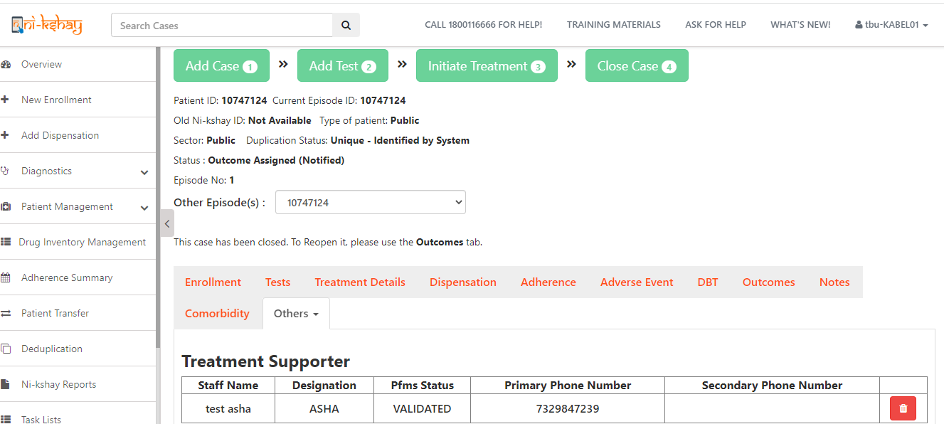
2. Assigning a Treatment Supporter to a Patient
Step 3: Assign Treatment Supporter to TPT beneficiary
Treatment Supporter cannot be unassigned if a benefit has been sent to PFMS or paid
A Treatment Supporter can be unassigned by clicking the delete button

Slide 75
Step 4: Manually create Benefits
Benefit can be created only if the following conditions are met:
A staff (Treatment supporter = Yes) is assigned as Treatment supporter to the beneficiary
The assigned staff has Eligible for Honorarium = Yes
Treatment Supporter’s Bank details are validated by PFMS
Treatment Status of beneficiary:
For TPT beneficiary , one benefit of maximum amount of Rs. 250 can be created if outcome is updated as “Treatment Completed
If all the above conditions are met, TU user can create Benefit for Treatment Supporter

Slide 76
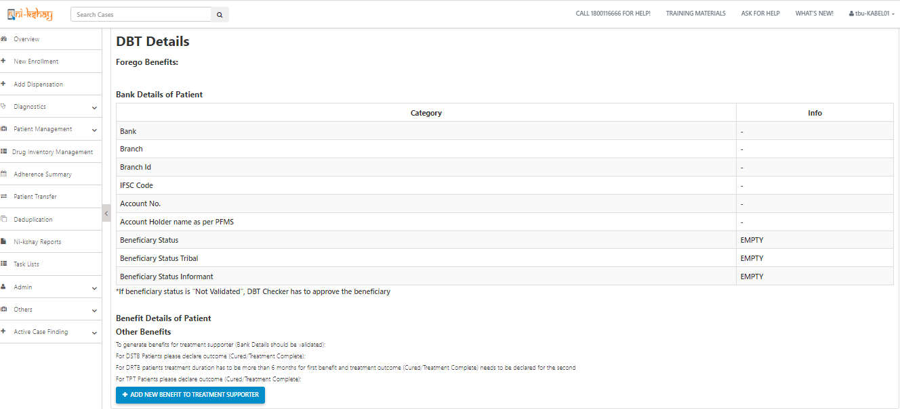
3. Creation of Benefits by TU
Step 4: Manually create Benefits
Login as TU User, open Patient’s Record for which Treatment Supporter Honorarium is to be paid, and Go to ‘DBT’ Tab
If eligibility conditions are met, benefit can be generated by clicking here

Slide 77
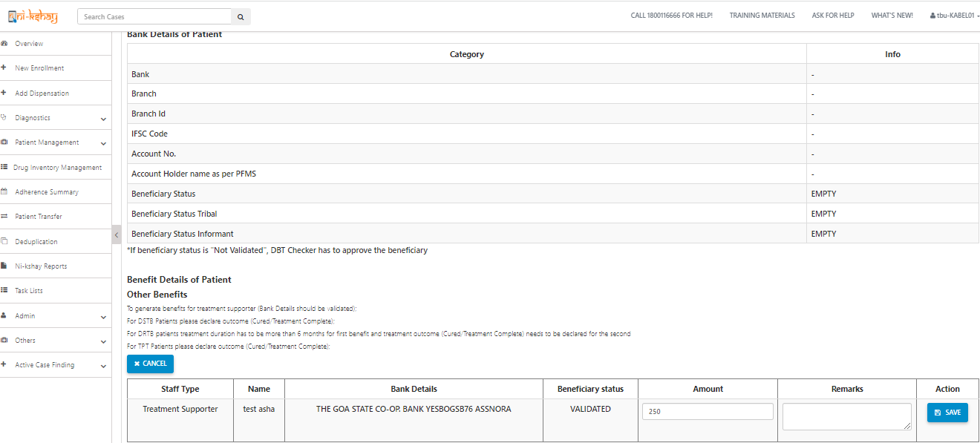
Step 4: Manually create Benefits
Enter amount and click on Save

Slide 78
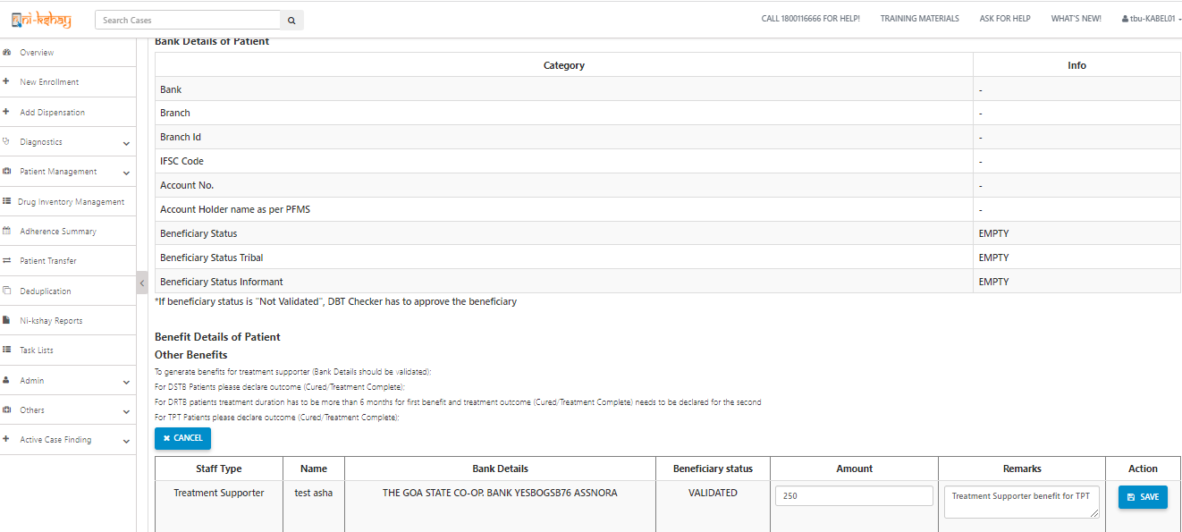
3. Creation of Benefits by TU
Step 4: Manually create Benefits
As user clicks on Save, Benefit will get created and notification displayed
Note: 1. A TPT beneficiary episode record cannot be deleted if benefit to the Treatment Supporter has already been sent to PFMS or paid 2. Edit of Case type (DSTB to DRTB/ DRTB to DSTB/ TPT to DSTB/ TPT to DRTB) will not be possible once benefit is generated under this scheme

Slide 79
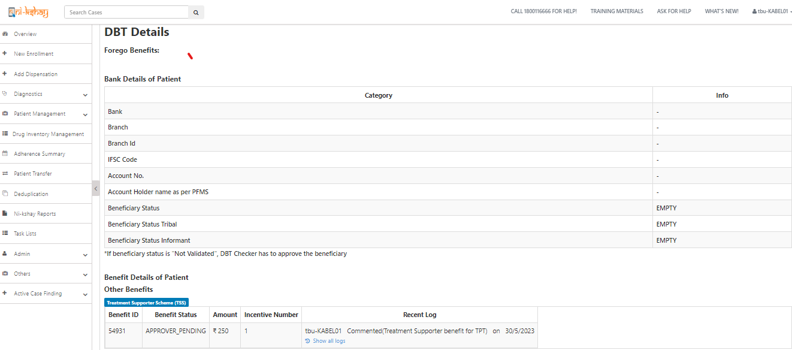
Step 5: Approval of Benefit by DBT Checker
Benefit will be available at DBT Checker login for approval.
Benefit Status can be seen here

Slide 80
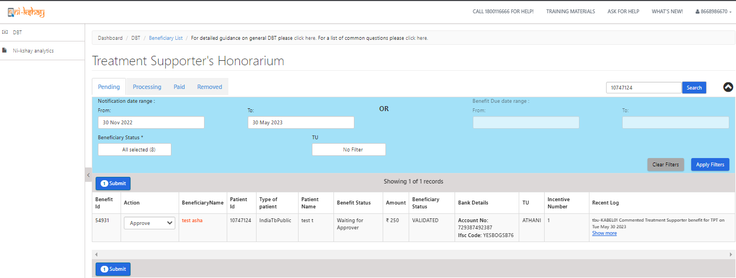
Step 5: Approval of Benefit by DBT Checker
The DBT Checker User will be able to process the Benefits

Slide 81
Handling of DBT benefits upon transfer of TPT beneficiary
Upon transfer of a TPT beneficiary to a hierarchy outside the existing TBU, all unprocessed benefits would be transferred along with the beneficiary to new hierarchy
All processed DBT benefits would not be transferred and status of payment need to be monitored from parent hierarchy itself

Slide 82
SOP for moving Treatment supporter to different hierarchy
Treatment Supporter Scheme for TPT cases:-
1. Users can register a staff with new bank details and generate a TSS benefit
2. We will delete all beneficiary bank account number in database which are in old hierarchy to avoid the duplicate pop message while entering bank account details in new hierarchy to same staffs
3. Processed & Unprocessed benefit will not move with beneficiary to new hierarchy
4. Users have the option to pay the old hierarchy benefits which are in status “Approver_Pending”.
5. Kindly follow below steps for payment where benefit under “Approver_Pening” in old hierarchy.
a. users can remove the treatment supporter from other tab where benefits is not processed
b. After removing the treatment supporter system will delete the TSS benefit which are under “Approver_pending” in backend
c. User need re-register same treatment supporter with bank details in new hierarchy
d. User can use the same bank details for payment since we have deleted old beneficiary (Isdeleted= 1)
e. Once beneficiary is validated by PFMS for new staff then you can assign the treatment supporter and create a TSS benefit by TU logins
f. After all this process, user can reassign the same Treatment supporter to beneficiary for further process
g. Create a TSS benefit manually from beneficiary DBT page by TU logins
h. Clear all backlogs benefits which are already under PFMS process to avoid the future rejection.

Slide 83
Module 7: Private Provider (HF) incentives scheme

Slide 84
How are PSN benefits generated by Ni-kshay
Incentives of Rs. 500 for Notification and Outcome Declaration will be provided to Private Provider (HF)
Presently, Ni-kshay enables users to pay only the ‘Private Health Facilities’ for Notification of TB patients and also for referring cases (informing) to Public Sector laboratories for diagnosis.

Slide 85
DBT processing via Ni-kshay
Following are the 6 steps to be followed for processing payments in Ni-kshay under this scheme.
1
Registration of Private Provider
2
Update Bank details of Private Provider
(Once per Private provider)
3
Approval of Bank Details by DBT Checker
4
Auto generation of benefits by Ni-kshay
5
Approval of Benefit by DBT Maker
(Once per benefit)
6
Approval of Benefit by DBT Checker
As this benefits are accepted in PFMS, they have to be approved in PFMS via DA Login

Slide 86
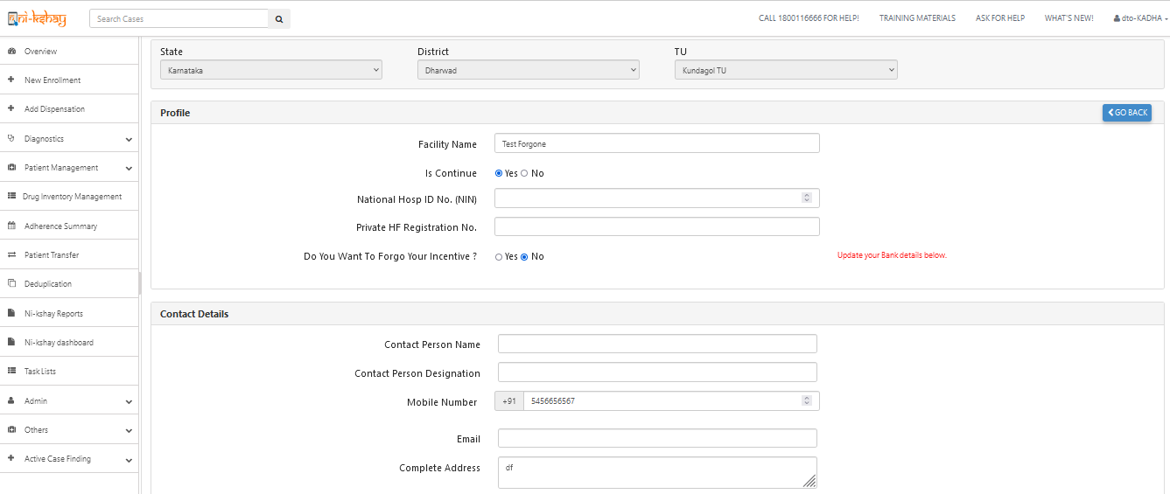
Step 1: Registration of Private Provider (HF) in Ni-kshay
Private Provider (HF) can be registered by a DTO or TU Login or by a Open form available in Ni-kshay Home Page and Default value for forgone as “NO”
If Provider is active, select ‘Yes’
Default value is selected “NO” & enter Bank details
Mobile No. must be unique

Slide 87
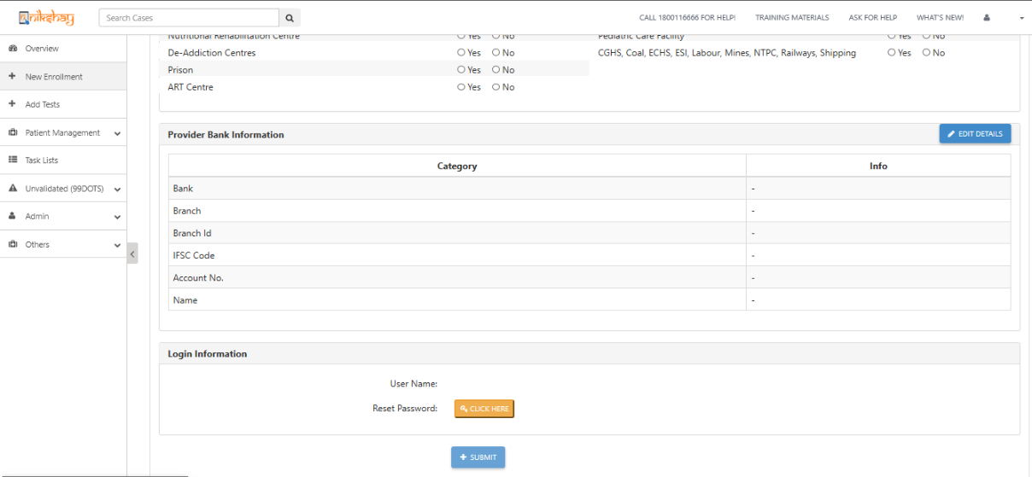
Step 2a: Update Bank details of Private Provider (HF)
Click on Edit details for update bank

Slide 88
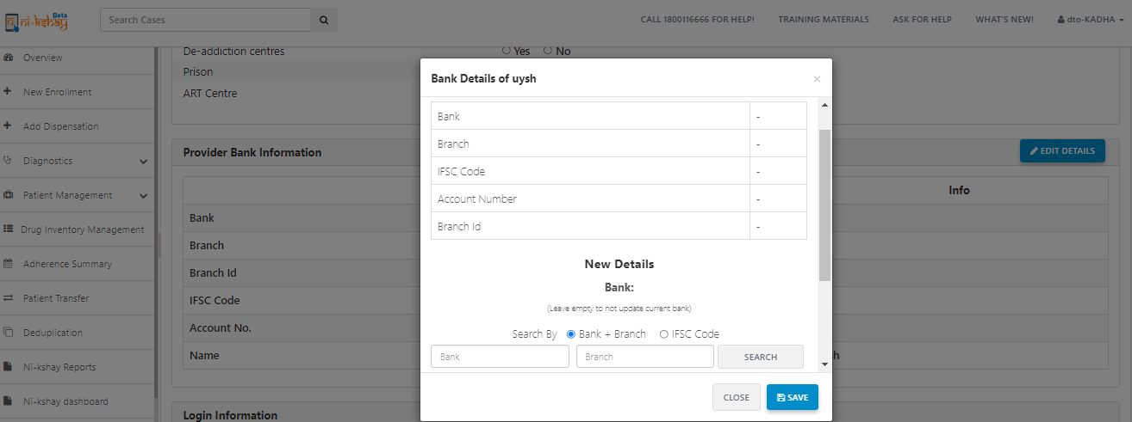
Step 2b: Update Bank details of Private Provider (HF)
Click on Edit details for update bank

Slide 89
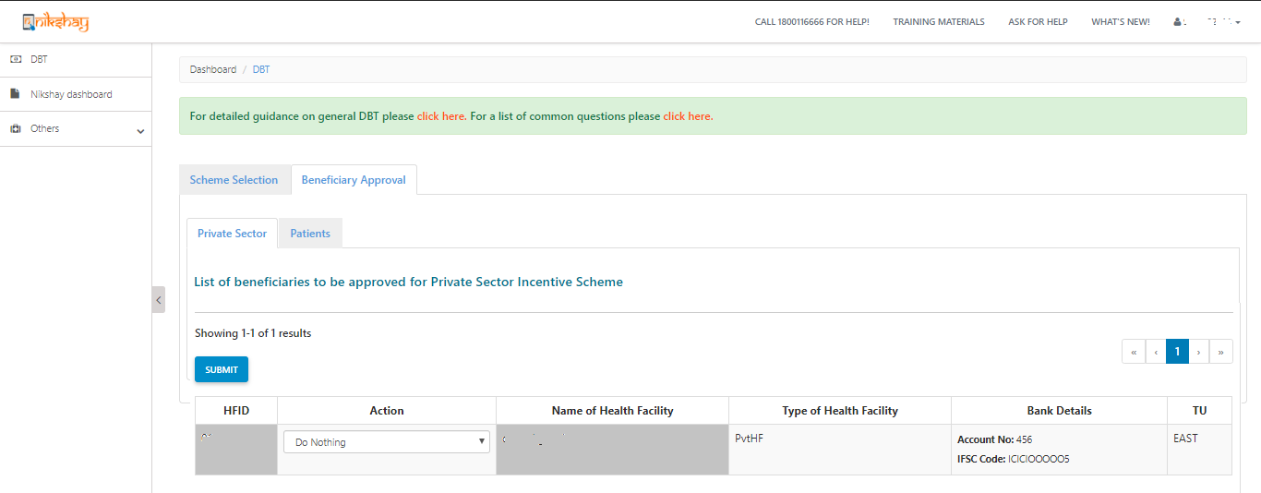
Step 3: to be taken in Ni-kshay at DBT Checker
As the Bank details of a Private Health Facility are entered, it is sent to DBT Checker for Approval. Such records are seen in “Beneficiary Approval” 🡪 “Private Sector” page.
If any Private Health Facilities Bank details are pending approval with DBT Checker, its Beneficiary Status will be “Not Validated”

Slide 90
Pre-requisites for Benefit generation under the scheme
The Private Health Facility should be in Active Status i.e.. “is Continue” should be selected as “Yes”
For the Private Health Facility “Do you want to forego incentive” should be selected as “No”
The Bank Account details of the Private Health Facility should be approved by DBT Checker and its Status should be “Validated”
Ni-kshay will generate Benefits only for episodes notified after “30th July 2019”. For all prior notifications, benefits may be paid directly through PFMS
Benefit will only be generated if the notified episode is “System identified Unique” or “Unique marked by users”.
Benefit will NOT be generated if episodes are marked as “System identified – Duplicates” and pending approval by user or “User marked - Duplicates”.

Slide 91
Step 4: Auto generation of benefit via Ni-kshay
Step 1
Step 2
Login with DBT Maker – staff ID
Click on Scheme
Login from “DBT Maker – Staff ID”
Scheme wise, Benefit Payment status

Slide 92
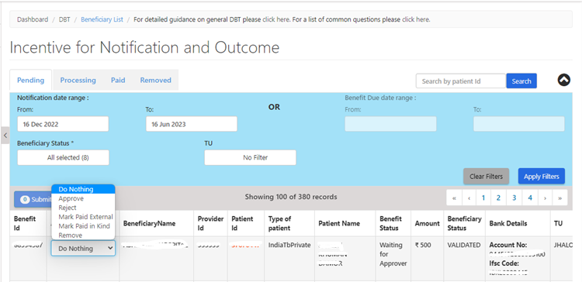
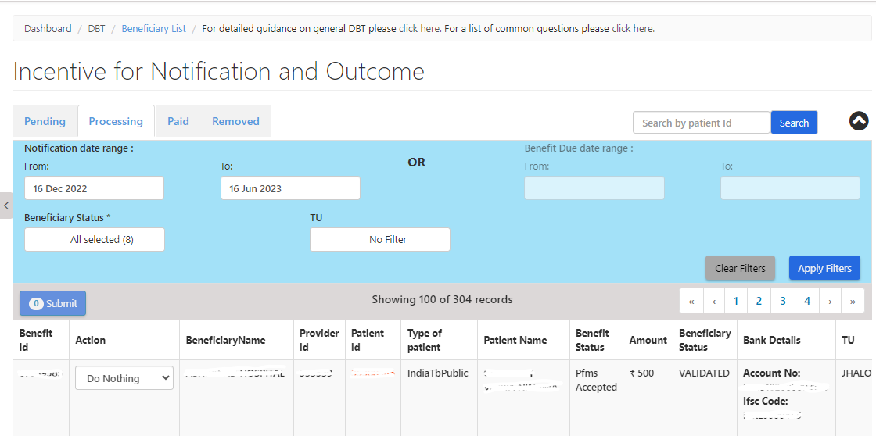
Steps to be taken in Ni-kshay at TU Level…
Step 1
Step 2
Step 3
Step 4
Step 5
Login with DBT Maker – staff ID
Click on Scheme
Apply DBT Search Filter
View the List of Eligible Benefits
Processing Benefits

Slide 93
Steps to be taken in Ni-kshay at DTO Level
Step 1
Login with DBT Checker– staff ID

Slide 94
Steps to be taken in Ni-kshay at DTO Level
Step 1
Step 2
Login with DBT Checker – staff ID
Click on Scheme

Slide 95
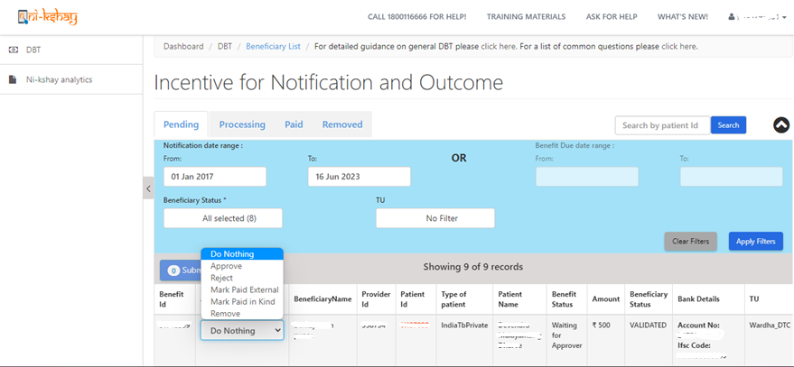
Steps to be taken in Ni-kshay at DTO Level
Step 1
Step 2
Step 3
Step 4
Login with DBT Checker – staff ID
Click on Scheme
Apply DBT Search Filter
View & Process Benefits

Slide 96
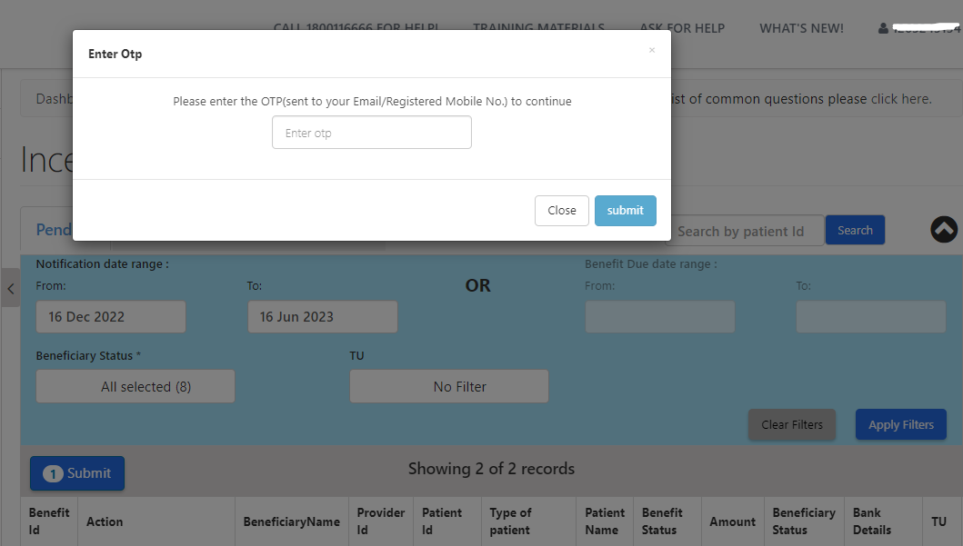
Steps to be taken in Ni-kshay at DTO Level
Step 1
Step 2
Step 3
Step 4
Login with DBT Checker – staff ID
Click on Scheme
Apply DBT Search Filter
View & Process Benefits
Enters OTP received on DTO’s registered mobile no.

Slide 97
Scenarios where Private facilities will be getting benefits
AddedBy | Level | HierarchyMapping_Enrollment | HierarchyMapping_Diagnosed | Eligible Beneficiary | Incentive Type
HUB | 5 | HUB | PVTLAB | HUB | NOTIFICATION
PVTCHEM | 5 | PVTCHEM | PVTLAB | PVTCHEM | NOTIFICATION
PVTLAB | 5 | PVTLAB | PVTLAB | Enrollment PVTLAB | NOTIFICATION
PVTHUB / State Jeet / District Jeet | 4 | HUB | PVTLAB | HUB | NOTIFICATION
TU | 4 | HUB | PVTLAB | HUB | NOTIFICATION
DISTRICT | 3 | HUB | PVTLAB | HUB | NOTIFICATION
PVTCHEM | 5 | PVTCHEM | PVTCHEM | PVTCHEM | NOTIFICATION
HUB | 5 | HUB | HUB | Enrollment HUB | NOTIFICATION
PVTHUB / State Jeet / District Jeet | 4 | HUB | HUB | Enrollment HUB | NOTIFICATION
TU | 4 | HUB | HUB | Enrollment HUB | NOTIFICATION
DISTRICT | 3 | HUB | HUB | Enrollment HUB | NOTIFICATION
Note:
Where there are two HFs involved, Informant (i.e. Enrolling HF facility) gets priority over Diagnostic facility
Benefits will be created in districts where private health facility is registered.
If a TU and above (Including JEET/ CC) enrolls a case on behalf of private health facility, and then refers a case for diagnosis to a public sector lab, then private health facility is not eligible for “Informant Incentive” i.e. Private Health facility has to login and refer cases for diagnosis to public sector to be eligible for “Informant Incentive”

Slide 98
Outcome benefit generation conditions
This incentive will be generated when a patient’s Treatment Outcome is declared.
Benefit will be generated only if Outcome is declared from “Private Practitioner/Clinic etc. (Single)” and “Hospital/ Clinic/ Nursing Home etc. (Multi)” irrespective of notification done.

Slide 99
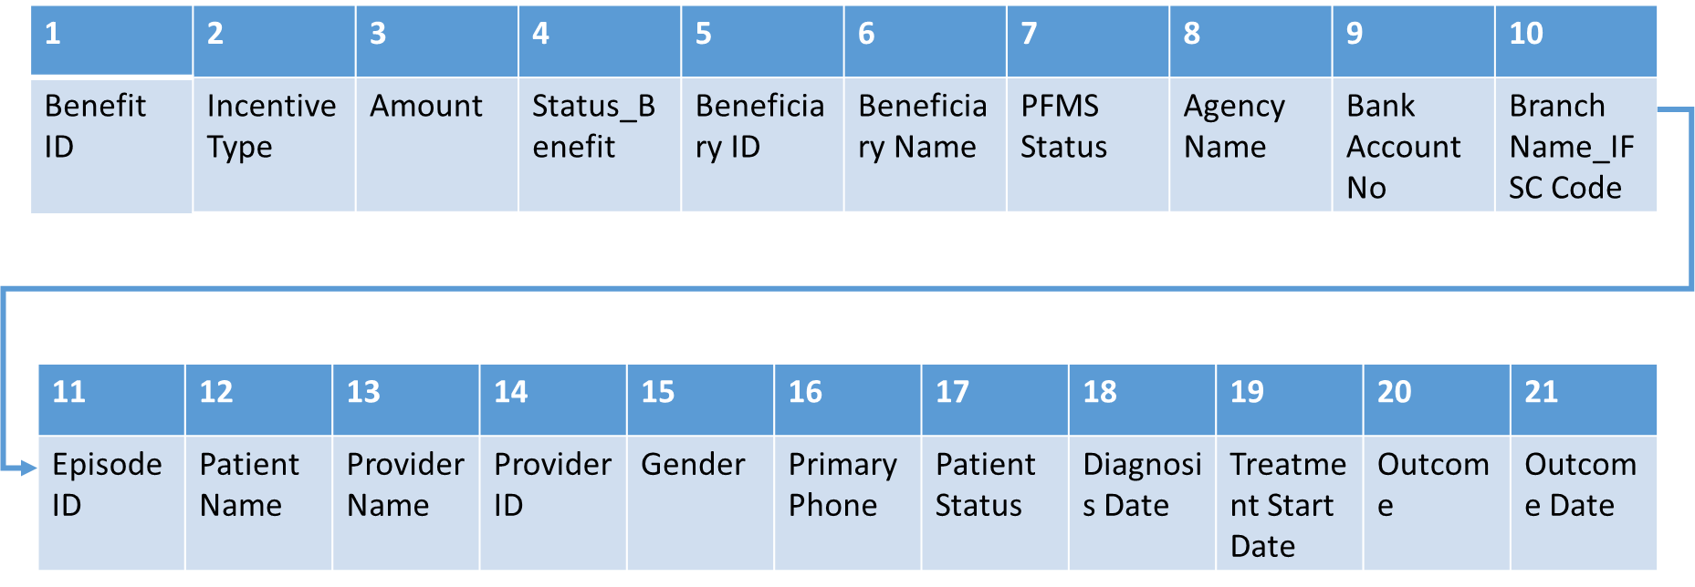
Report available to Private Provider (HF)

Slide 100
Informant DBT module under NTEP -
Ni-kshay workflows
Last Updated on 20th October,2022

Slide 101
Contents
Introduction
Informant registration
Presumptive TB registration
Enroll a patient through TB Screening tool
Informant tag for PHI/other users
DBT maker workflow
DBT Checker workflow
Ni-kshay DBT Dashboard
Staff and Treatment Supporters

Slide 102
Introduction
Informant can facilitate referral of a presumptive TB patient to any Designated Microscopy Center or a molecular testing laboratory in the public sector; and if the person is diagnosed as confirmed TB patient at such center, and has not been notified earlier by the public/private sector in Ni-kshay, the informant would be eligible to get an incentive of Rs.500/- for notification.
Ni-kshay portal enables a beneficiary to register as an informant and facilitate registration of a presumptive TB patient within the system.
Incentives of Rs. 500 for Informant, Notification and Outcome Declaration will be provided to Private Provider (HF) & Staff get informant incentive.
Staff who have the following designations can be added as Informants - Asha, NGO Volunteer, Other Community Volunteer, Private practitioner, Citizen, Informal Provider
Staff and Treatment Supporters

Slide 103
Informant user flow
Staff and Treatment Supporters

Slide 104
Step 1- Informant Registration
New Informant Registration Page is accessible to anyone who visits the website www.Ni-kshay.in

Slide 105
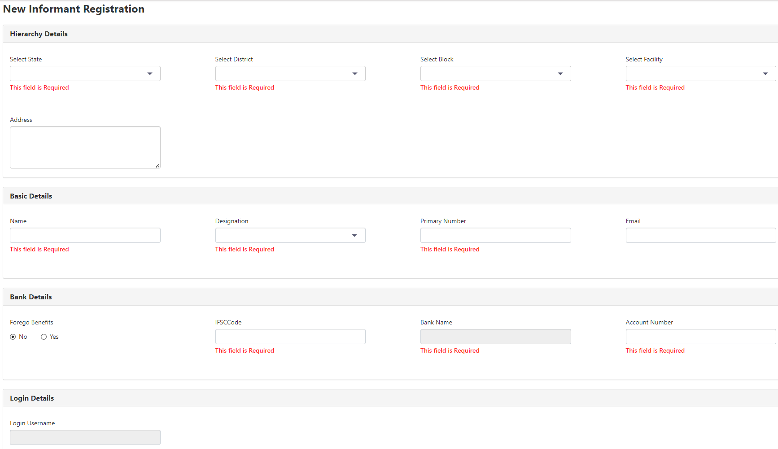
Informant registration page
Enter all fields that are required.
Duplication check is there on Primary Number and Bank account details
Mobile No. must be unique
Bank details must be unique

Slide 106
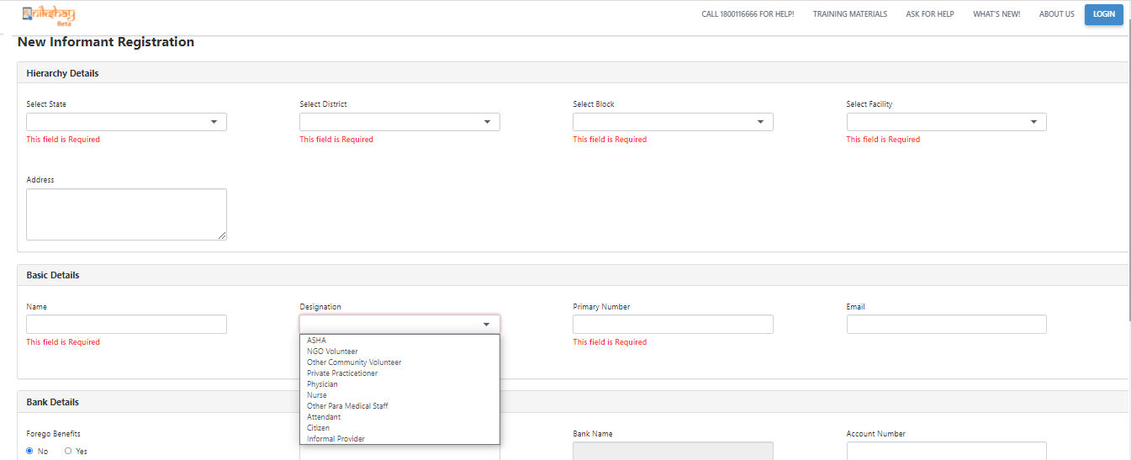
Informant registration page
Different designations of the Informant

Slide 107
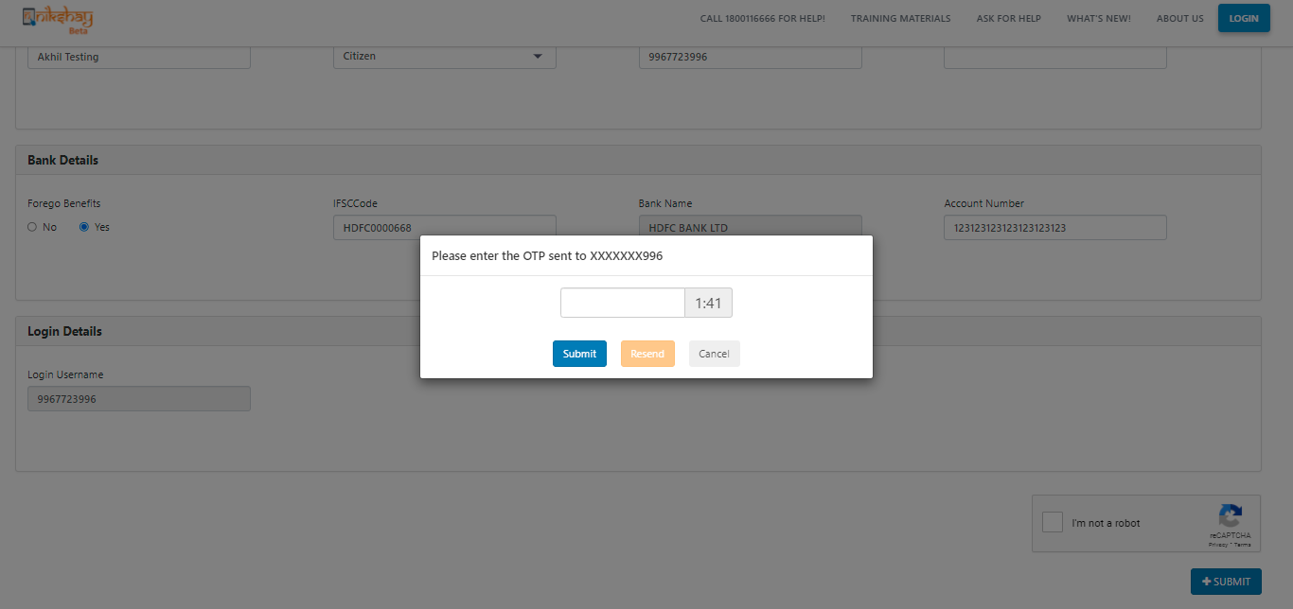
OTP verification
Enter OTP received on phone number that is valid for 2 mins
A Resend OTP option can be used twice to get a valid OTP
On successful confirmation, the staff is created in Ni-kshay.
The username will be the phone number and an auto generated password will be sent to the phone number entered

Slide 108
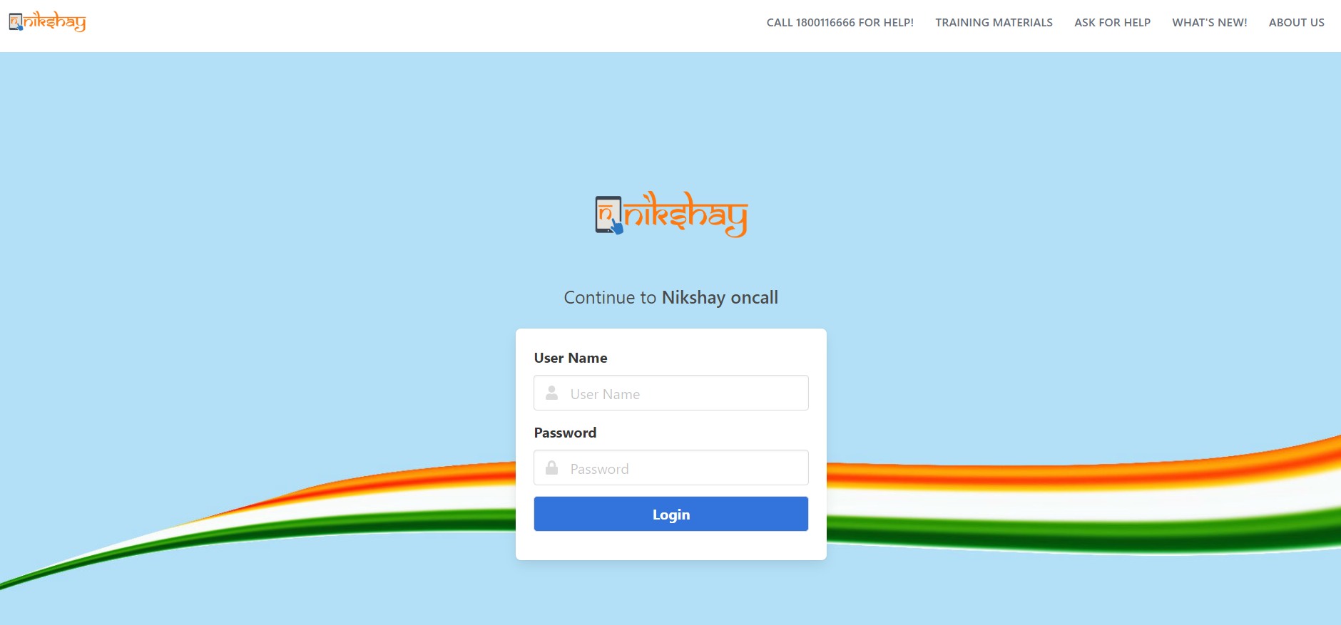
Step 2- Informant Login
Login using the username and password. User will be asked to reset the password.
Please reset the password in order to login in Ni-kshay

Slide 109
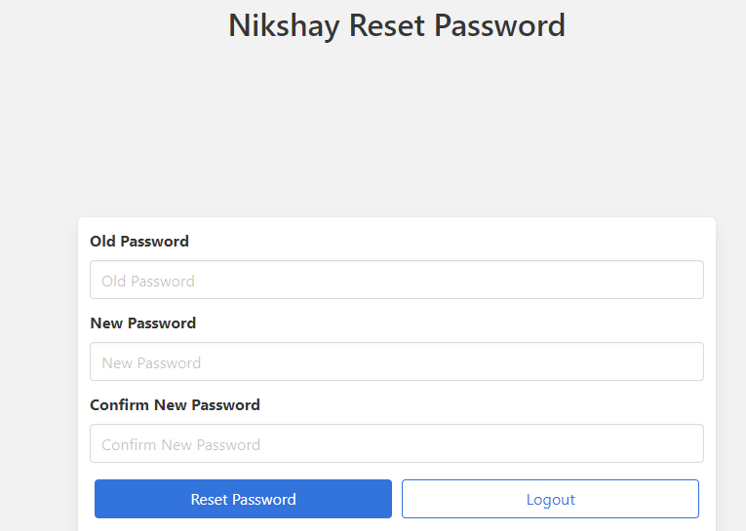
Reset password page

Slide 110
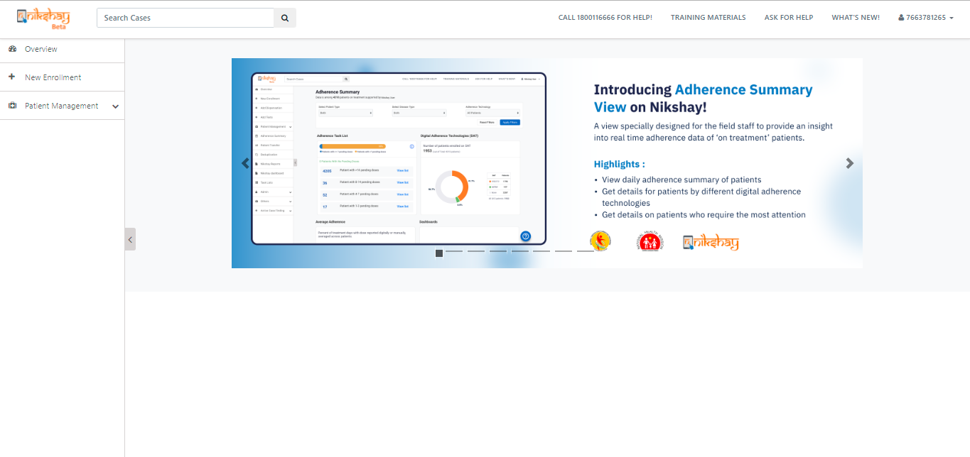
Step 3- Access in Ni-kshay
After login, only Overview, Patient Management and New Enrollment would be shown for Citizen and informal providers

Slide 111
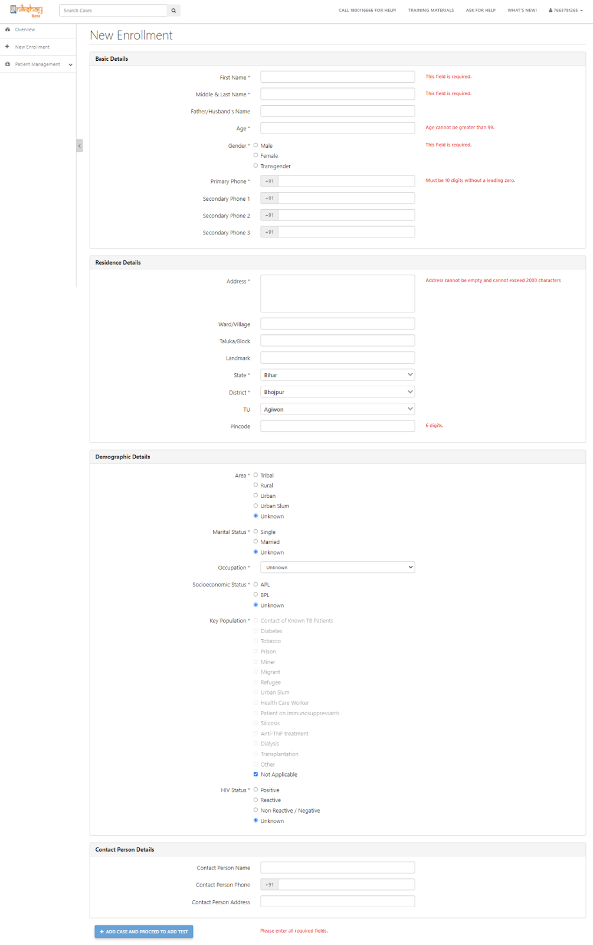
Step 4: Enrolling a Presumptive patient
On Clicking on New Enrollment, the user can enroll a presumptive patient.
On successful completion of enrollment form, the presumptive patient gets added to Ni-kshay

Slide 112
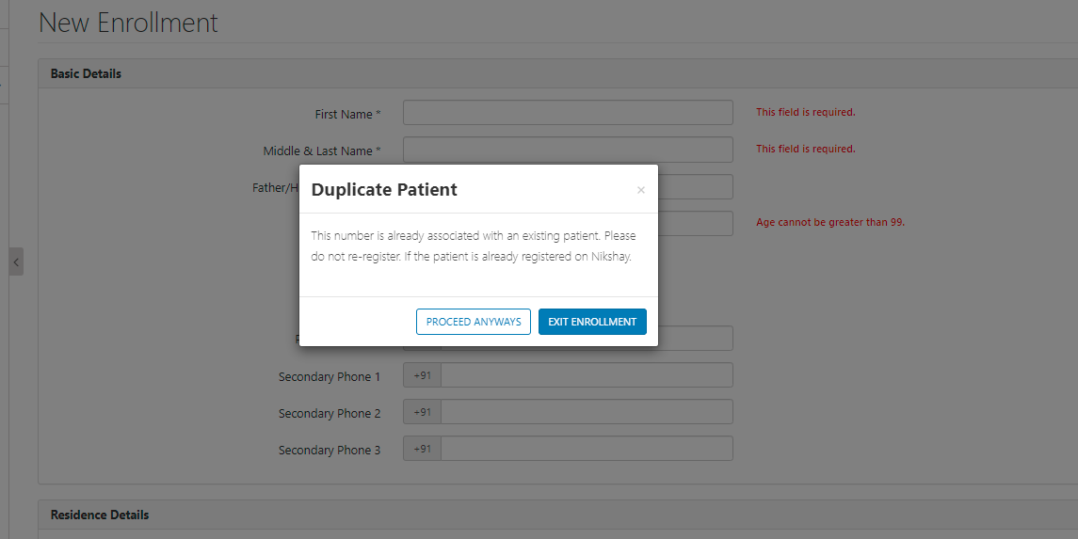
Deduplication check for Presumptive patients
In case there are duplicate patients (patients with same phone number and gender) we will show a message to reduce the duplicates. However we will allow only upto 5 patients to be registered using the same phone number.

Slide 113
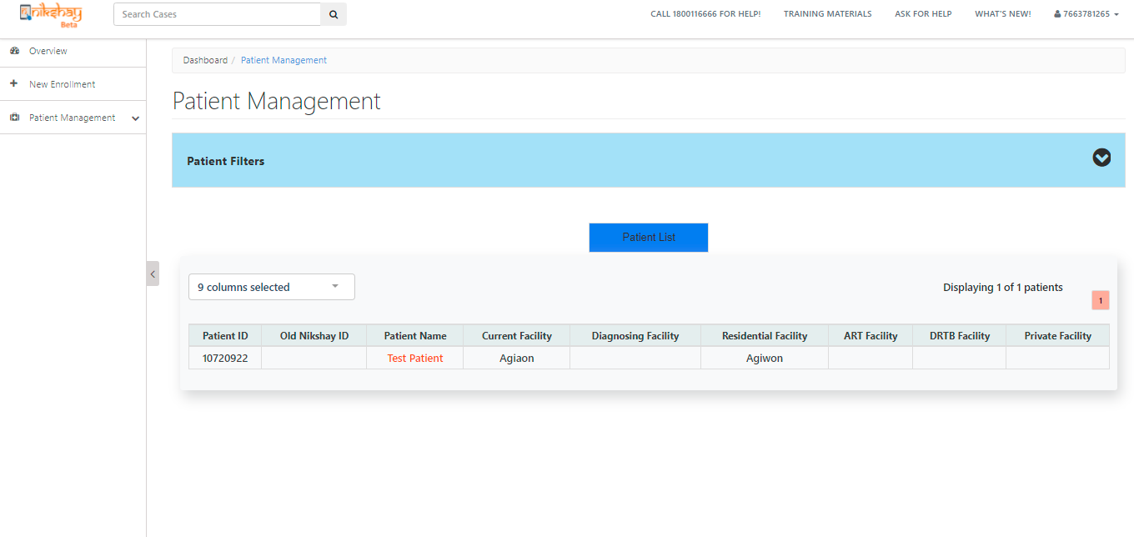
Added patient visible in the patient management module

Slide 114
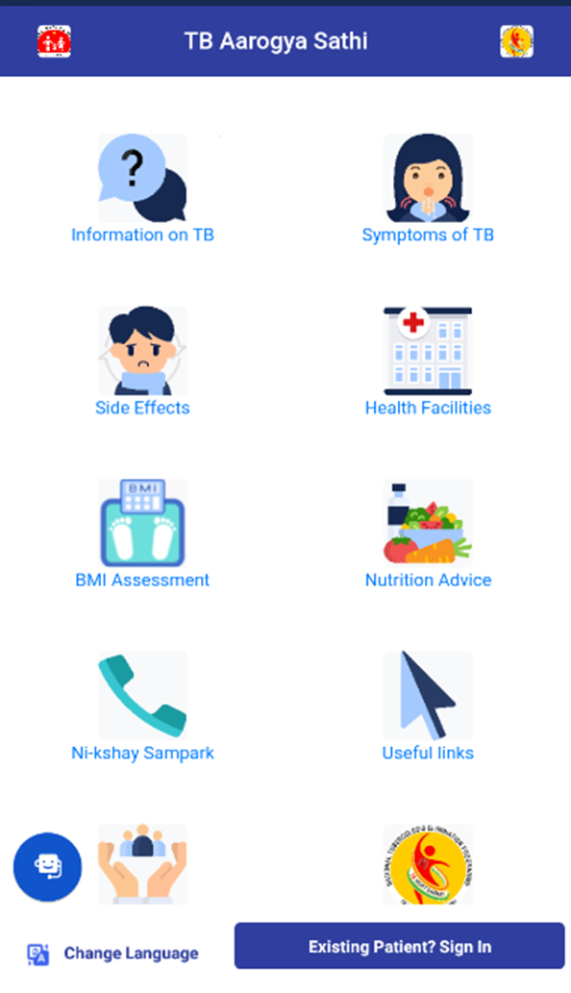
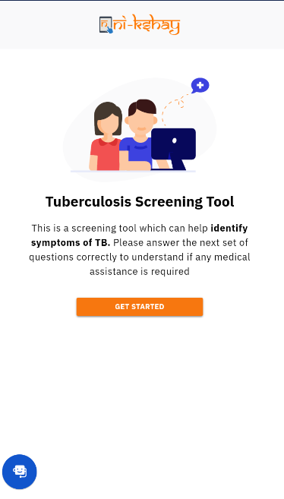
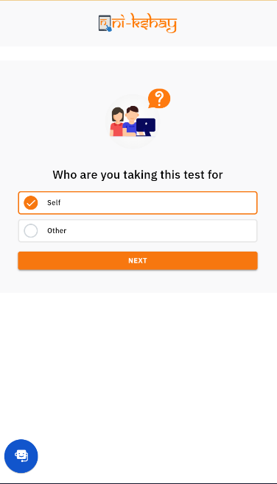
Enroll a patient through TB Screening tool
>>Click on Symptoms of TB
>> click on Get Started
>>select Self option for enrollment

Slide 115
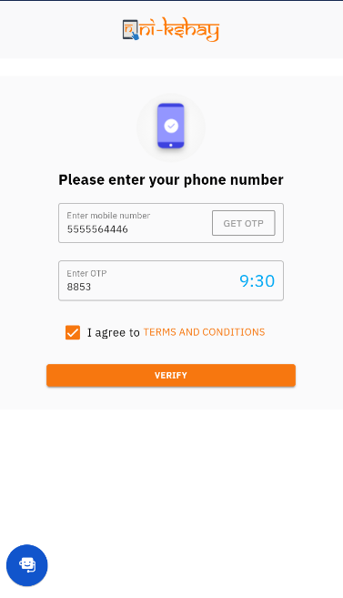
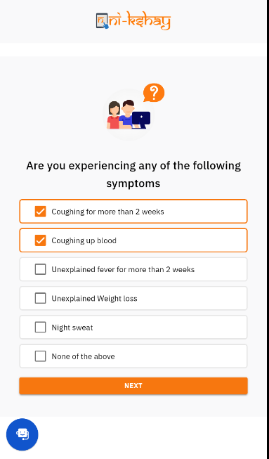
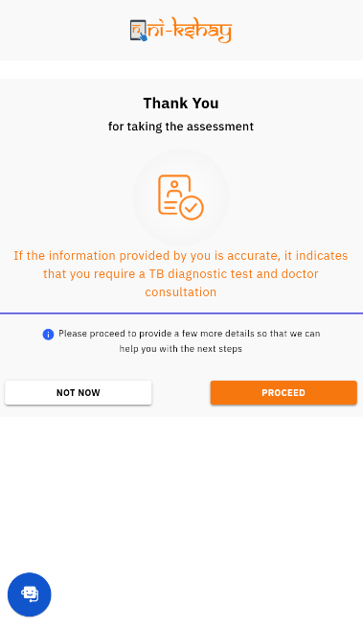
Enroll a patient through TB Screening tool
> Enter Mobile number
> Verify the OTP
> Select the symptoms
> Click on proceed for next step

Slide 116
Enroll a patient through TB Screening tool
>> Fill Basic details
>> Select State, District & TBU
>> Select public sector health facility
>>Now patient is enroll as presumptive
patient

Slide 117
Basic details of added patients
Added patient is visible however, the informal provider/citizen will only be able to edit the basic details of the patient.
No other action can be taken for the added patient.

Slide 118
Informant entry through PHI logins
For PHI logins, add informant details is part of the registration page.

Slide 119
Informant can be added/removed in Staff/Treatment Supporter page
PHI/ TBU/ District can add/remove Informant in the Staff/Treatment Supporter page

Slide 120
Addition of staff as Informants
Staff who have the following designations can be added as Informants-
Asha, NGO Volunteer, Other Community Volunteer, Private practitioner, Citizen, Informal Provider

Slide 121
DBT Maker page for Informant incentives
New section introduced for informant incentives

Slide 122
DBT Checker page for Informant incentives
New section introduced for informant incentives

Slide 123
DBT Checker - Beneficiary workflow

Slide 124
Ni-kshay DBT Dashboard

Slide 125
Scenarios where Informant incentive would be applicable
Added by | Enrolment by (i.e. Login used) | Diagnosis | Beneficiary | Incentive Type
HUB | HUB | PHI | HUB | Informant
PHI | PHI | PHI | INFORMANT/PATIENT | Informant
PVTCHEM | PVTCHEM | PHI | PVTCHEM | Informant
PVTLAB | PVTLAB | PHI | PVTLAB | Informant
PVTHUB / State Jeet / District Jeet | HUB | PHI | HUB | Informant
TU | PHI | PHI | INFORMANT/PATIENT | Informant
TU | HUB | PHI | HUB | Informant
DISTRICT | PHI | PHI | INFORMANT/PATIENT | Informant
DISTRICT | HUB | PHI | HUB | Informant
INFORMANT | PHI | PHI | INFORMANT | Informant

Slide 126
FAQs
1.What is the benefit generation timeline for Informant scheme?
>>The Informant Incentive should be generated to the informant only after 7 days from date of diagnosis.
2.This form seems to be quite complex. Is there any way of simplifying it or reducing some non- mandatory indicators?
>>Currently users need to fill the basic & residentials fields which are mandatory in enrollment form. Total mandatory fields are 7 in enrollment form.
Staff and Treatment Supporters

Slide 127
Module 10:
ASHA/community volunteers Bank Account Seeding Module

Slide 128
Background of Asha bank account seeding
The Ministry of Health and Family Welfare, GoI has announced financial incentives for ASHA or community volunteers for ensuring seeding of bank account details of notified TB patients in the Ni-kshay portal. This is a new incentive for ensuring and expediting the process of bank account availability and seeding in Ni-kshay portal within 15 days of TB treatment initiation. In order to ensure uptake of the above activity, ASHAs or Community Volunteers have an incentive of INR 50 for every notified TB episodes or cases.

Slide 129
Beneficiary eligible for this scheme and amount details in Ni-kshay
Any community volunteer who is not a salaried employee of state/central government. This includes ASHA, ANW, Trained dais and village health guides
An incentive of INR 50 per notified TB patient for seeding of bank account details on the Ni-kshay portal.
All ASHA or community volunteers who facilitate the seeding of bank accounts of all TB patients notified on or after 7th September 2022 are eligible for incentives under this activity.

Slide 130
Step 1: Bank account seeding register

Slide 131
Step 2: Reconciliation form of incentive for bank account seeding

Slide 132
Step 3: Reconciliation report of incentive for bank account seeding

Slide 133
Single Nodal agency mechanism

Slide 134
Important terms under SNA
PFMS- Public Financial Management System
CSS- Centrally sponsored schemes (CSS)- 9156/4063- National Health mission
SLS- State-linked schemes- Linked scheme against CSS of State/UT
ZBSAs- Zero balance subsidiary account at IAs
SNA- Single nodal agency- Agency of program linked as parent agency in PFMS
IAs- Implementing agencies- Agencies implementing the program
SPMU- State project management unit of PFMS at the state level

Slide 135
Single Nodal account mechanism
Central Level
CSS at Central level-NHM-4063
State-linked schemes (SLS) linked with CSS via Single Nodal Agency having account in PFMS
ZBSAs-1 account at the IAs level
ZBSAs-2 account at the IAs level
State Level
Implementing level (State/District)

Slide 136
Comparison of the revised process
Basis | Older process | Process with SNA
Scheme | Presently all DBT payment under Centrally sponsored schemes (CSS)-NTEP- 4063 | All CSS to be linked with newly created State linked schemes
Single Nodal account and ZBSA | Single Nodal account and ZBSA may not be available at State and district level respectively | Single Nodal account and ZBSA need to open at State and district level respectively
Budget lines | Separate budget line for central and state share may not be available in Treasury interface | Creation of Separate budget line for central and state share
Beneficiary, Purpose and DBT mission code | Beneficiary, Purpose and DBT mission code used under NTEP-9156 | Beneficiary, Purpose and DBT mission code to be used under NTEP-State linked scheme
Revalidation of beneficiaries | NA | Revalidation of beneficiary from UI level in Ni-kshay-: For TB Patients - Patient management module For Supporter - Admin module

Slide 137
Frequently Asked Questions
Question | Answer
Transport support for tribal scheme for tribals areas only ? | No, For Tribal/Hilly/difficult areas
Tribal patient transfer to the Non-Tribal areas benefits eligible for incentive ? What happen to already generated benefits ? | Benefits removed automatically
Benefits generated due to change in regimen under NPY and PSN to be processed ? | No
What's the definition of outcome for Outcome incentive and Treatment supporter honorarium incentives ? | Outcome incentive: Any outcome Treatment supporter honorarium incentive : Cured/Completed
Can both the informant and notification benefits be paid for a single patient (to different beneficiaries)? | No, Either of one
What do you mean by eligible beneficiary in DBT for monitoring ? | Eligible beneficiary reduced by forgone, wrongly diagnosed and removed benefits.
ASHA become TB patient can same bank account utilized for DBT ? | Yes
Patient died during the course of treatment is eligible for the incentive ? | Technically yes- Policy call
Bank not available in Ni-kshay but available in PFMS DBT possible? Bank not available in PFMS but available in Ni-kshay DBT possible? | Yes No

Slide 138
Frequently Asked Questions
Question | Answer
Beneficiary in SENT/under process status in Ni-kshay for extended period of time solution ? | Follow the SoP for beneficiary in SENT status and share details to CTD
Benefits in SENT/under process status in Ni-kshay for extended period of time solution ? | Follow SoP for benefits in SENT status and share details to CTD
Can a different treatment supporter be assigned for the DRTB treatment support in cases where a patient starts treatment as a DSTB patient, gets a treatment supporter assigned and then moves from the DSTB to DRTB regimen. If yes, can both treatment supporters be paid? | Please note that at any given time there will be only one treatment supporter assigned to a patient

Slide 139
Thank You

